Slide 1
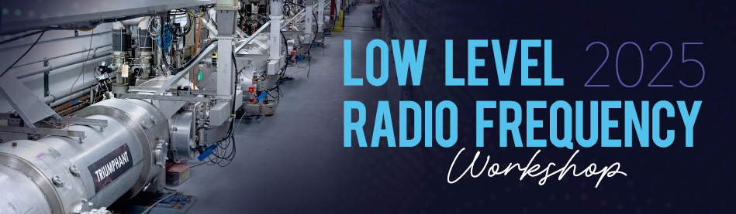
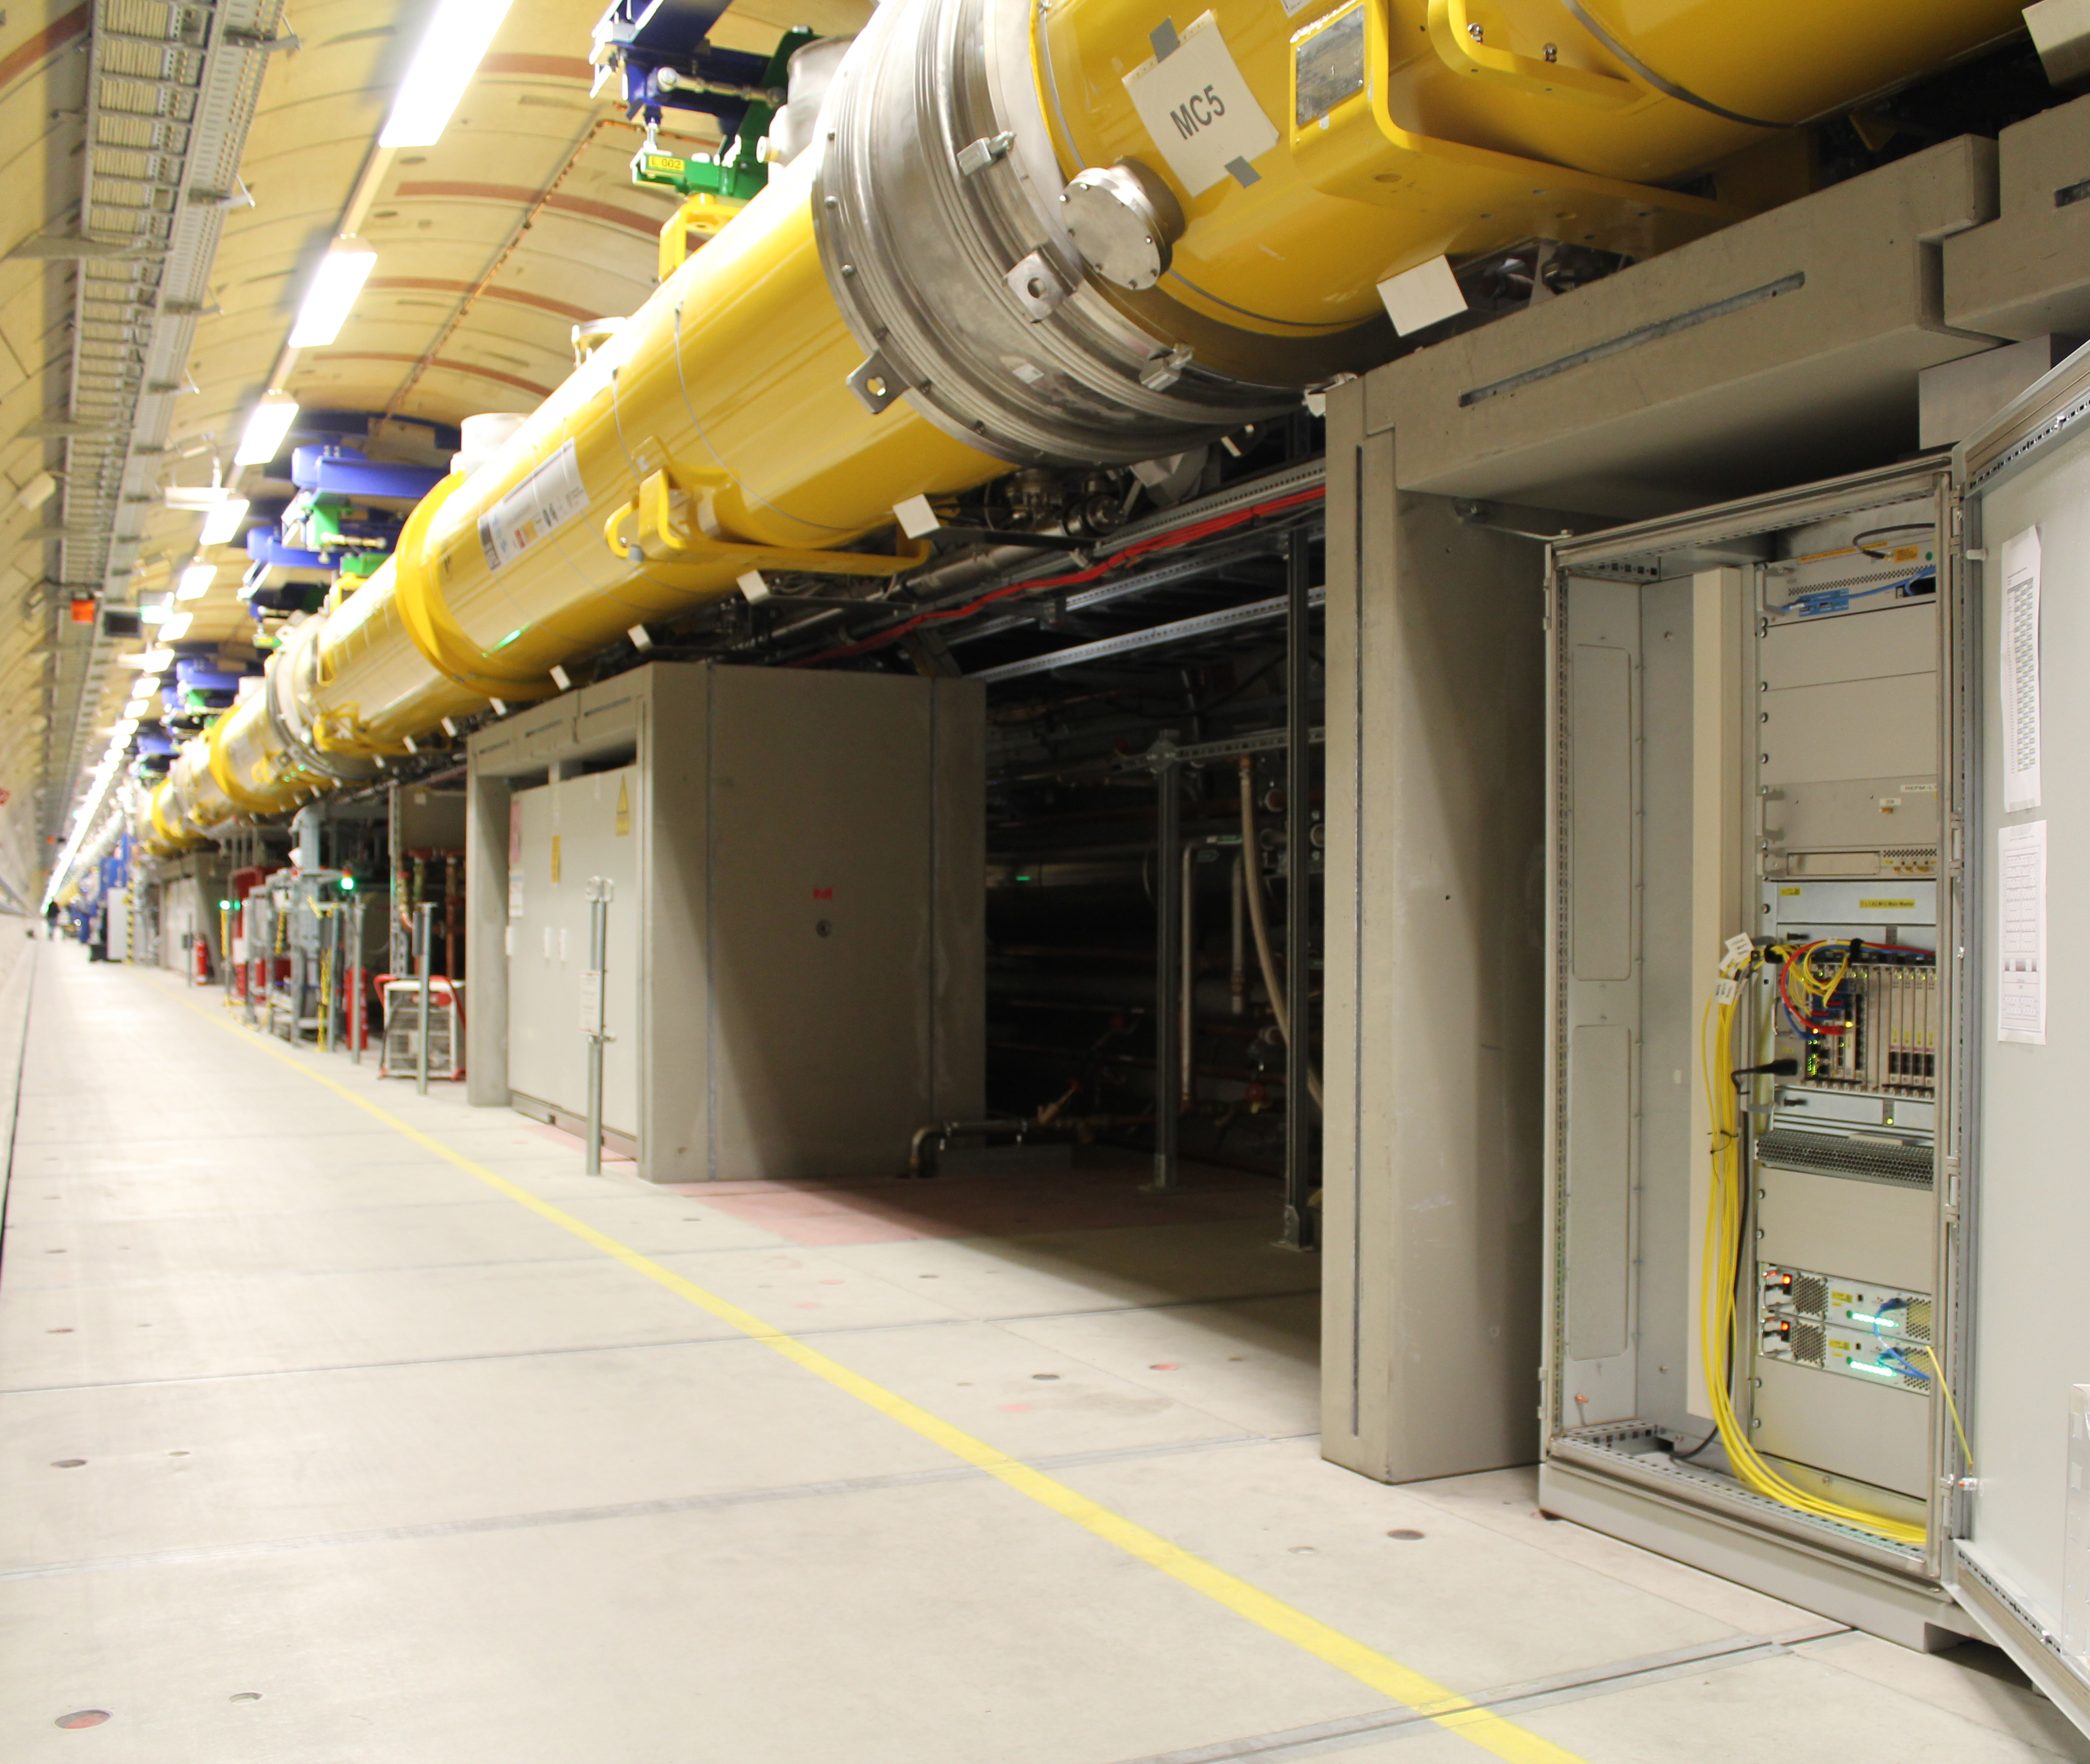


DESY. Update on LLRF systems
Low Level Radio Frequency Workshop
Newport News, VA, USA
13-16 oct. 2025
Julien Branlard, for the LLRF team

Slide 2
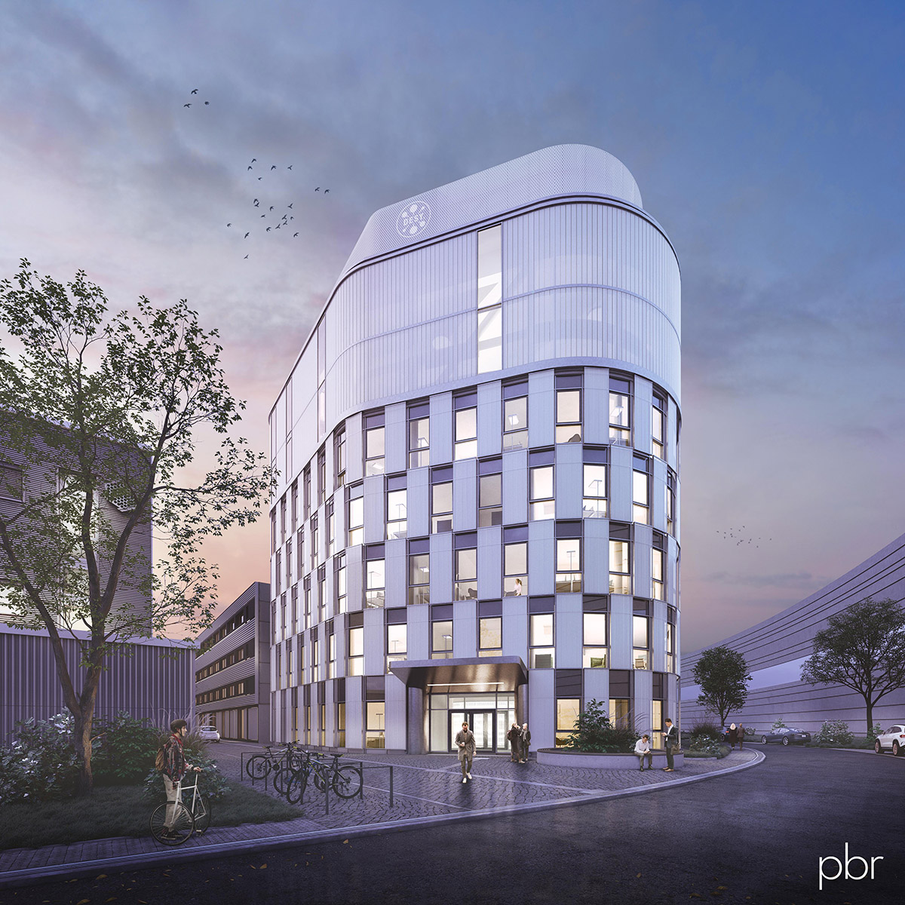
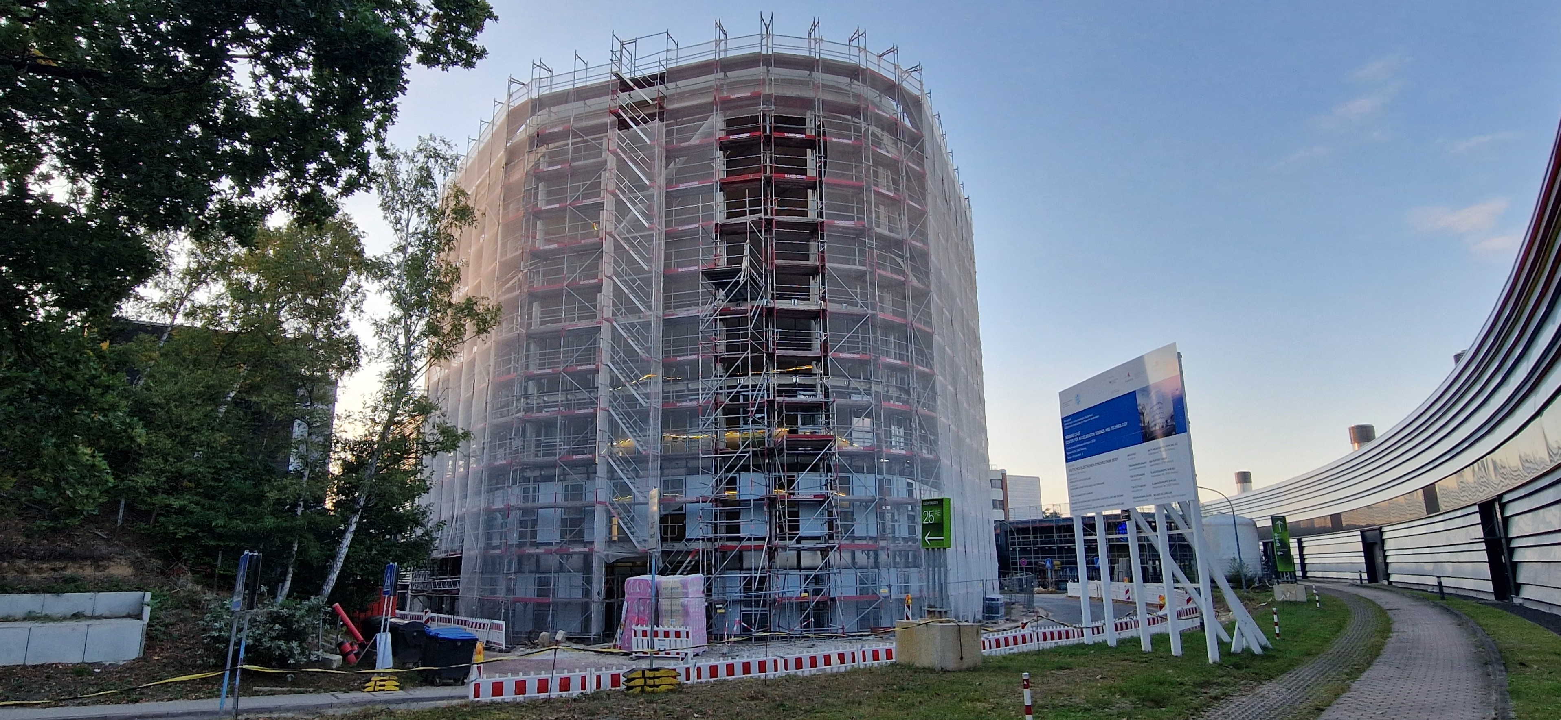
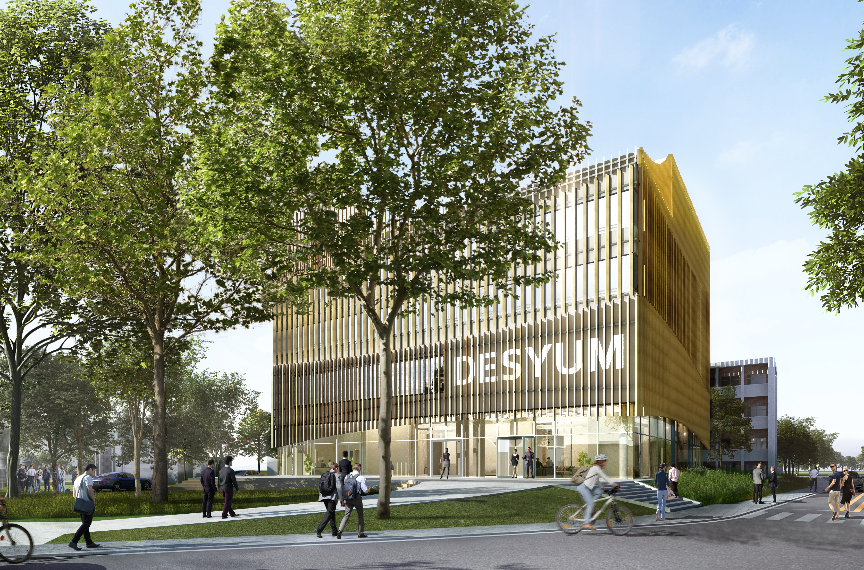
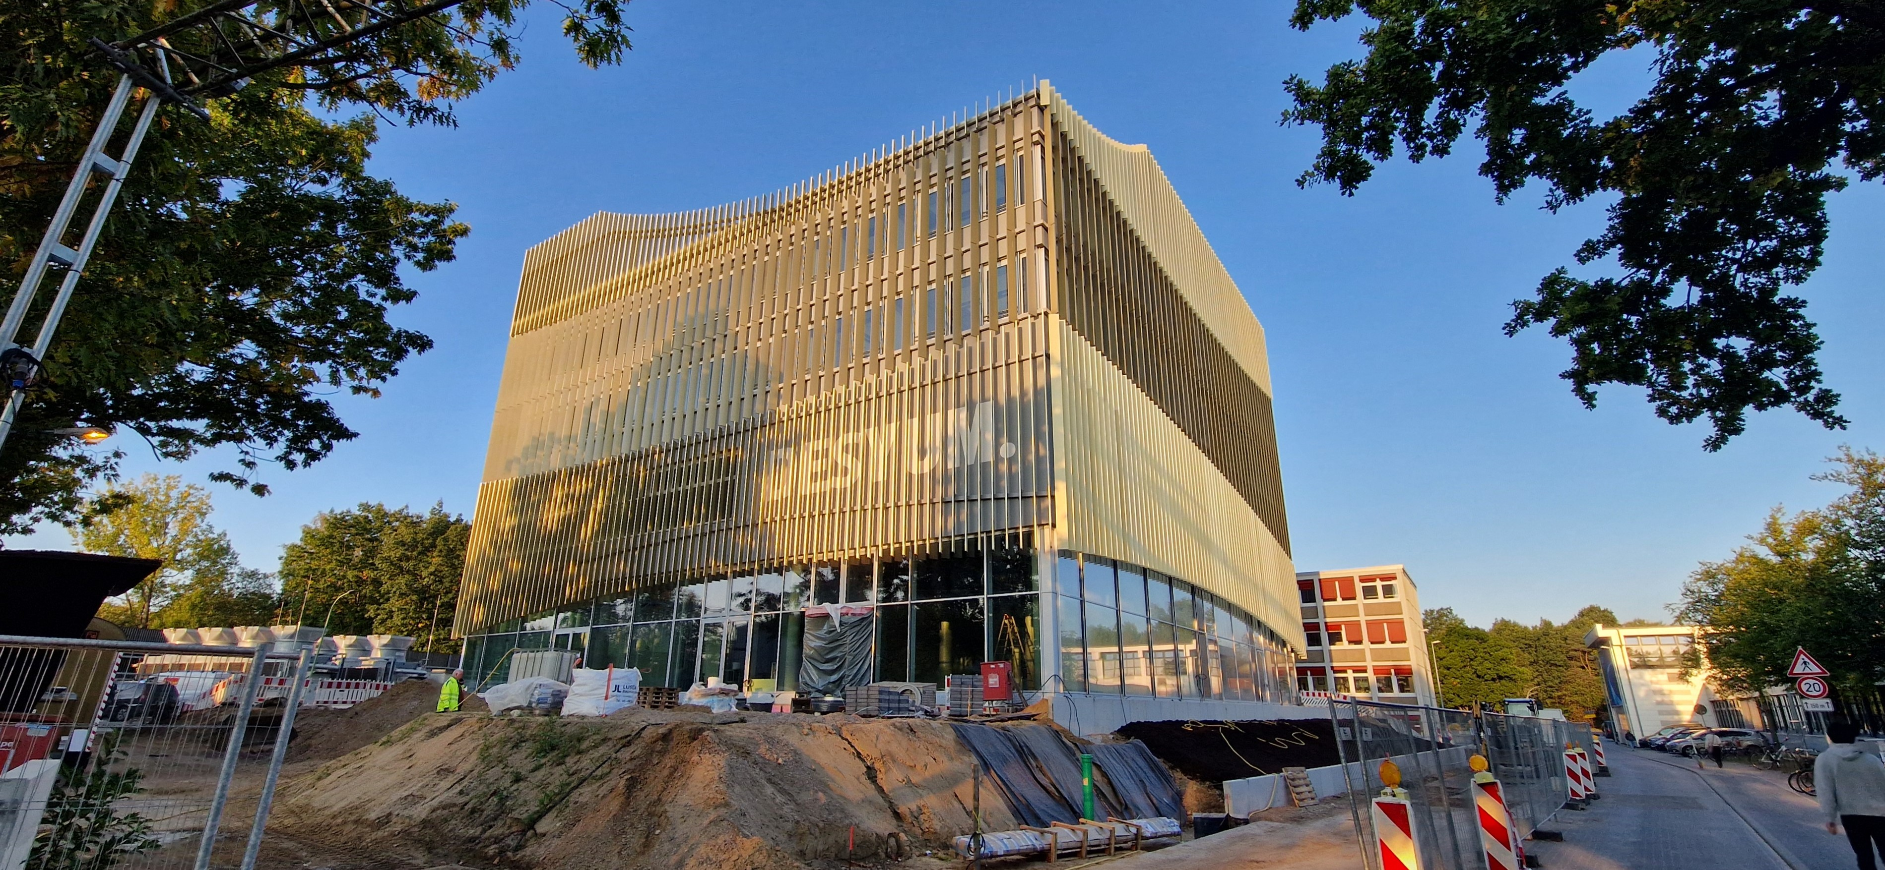
DESY campus = construction site
Artist’s view
Sept.2025
CAST
Center for Accelerator Science and Technology (new control room)
Artist’s view
Sept.2025
DESYUM
New visitor center
(opening 2025)

Slide 3
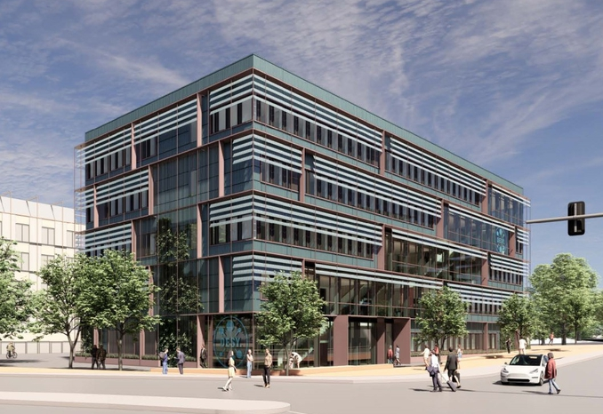
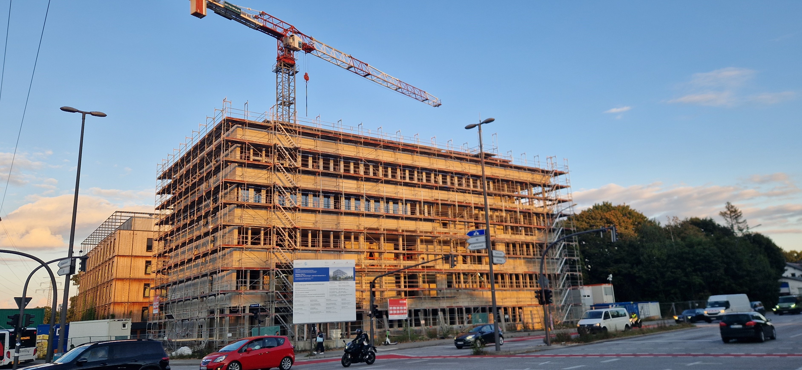
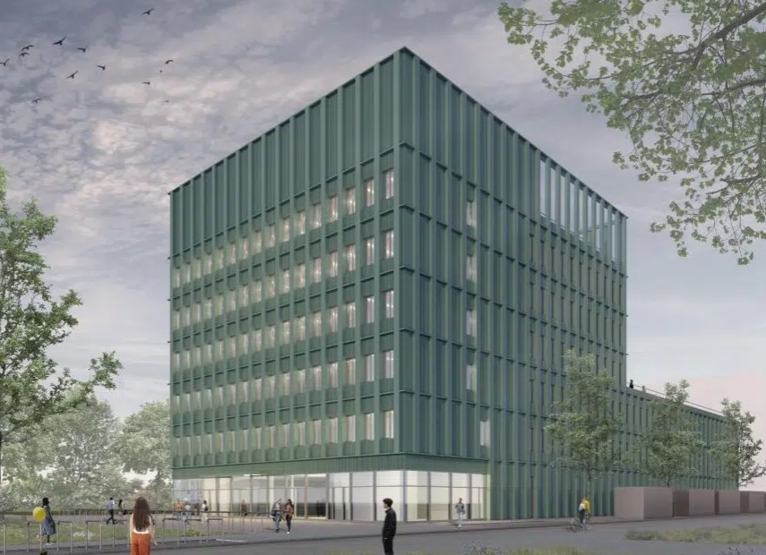
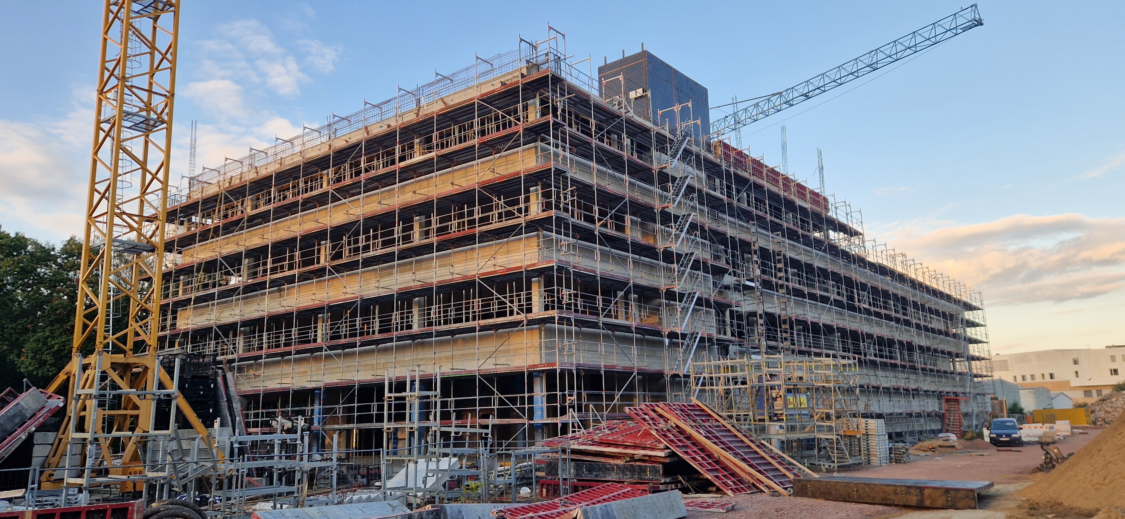
DESY campus = construction site
Artist’s view
Sept.2025
Innovation Factory
(Deep tech, startup, research and technology transfer)
Artist’s view
Sept.2025
Innovation Factory 2
(opening 2027)

Slide 4
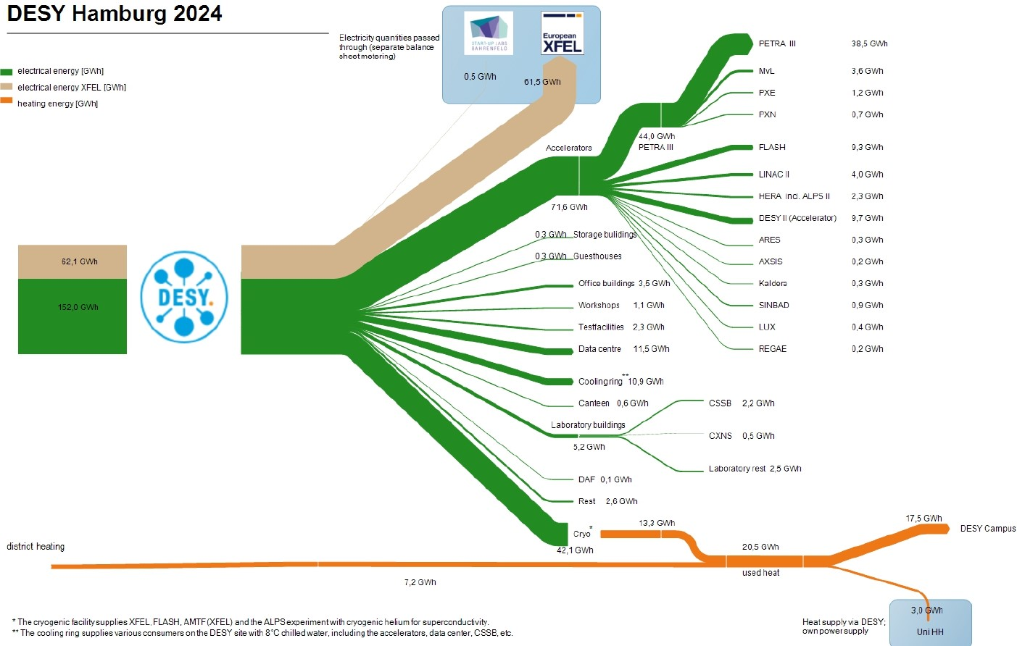
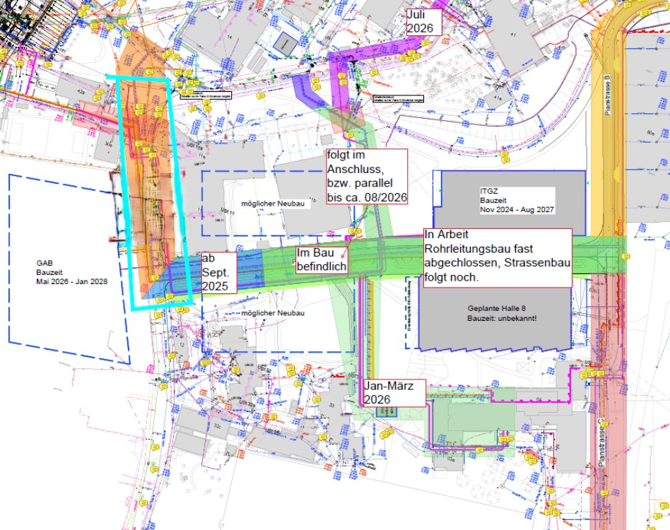
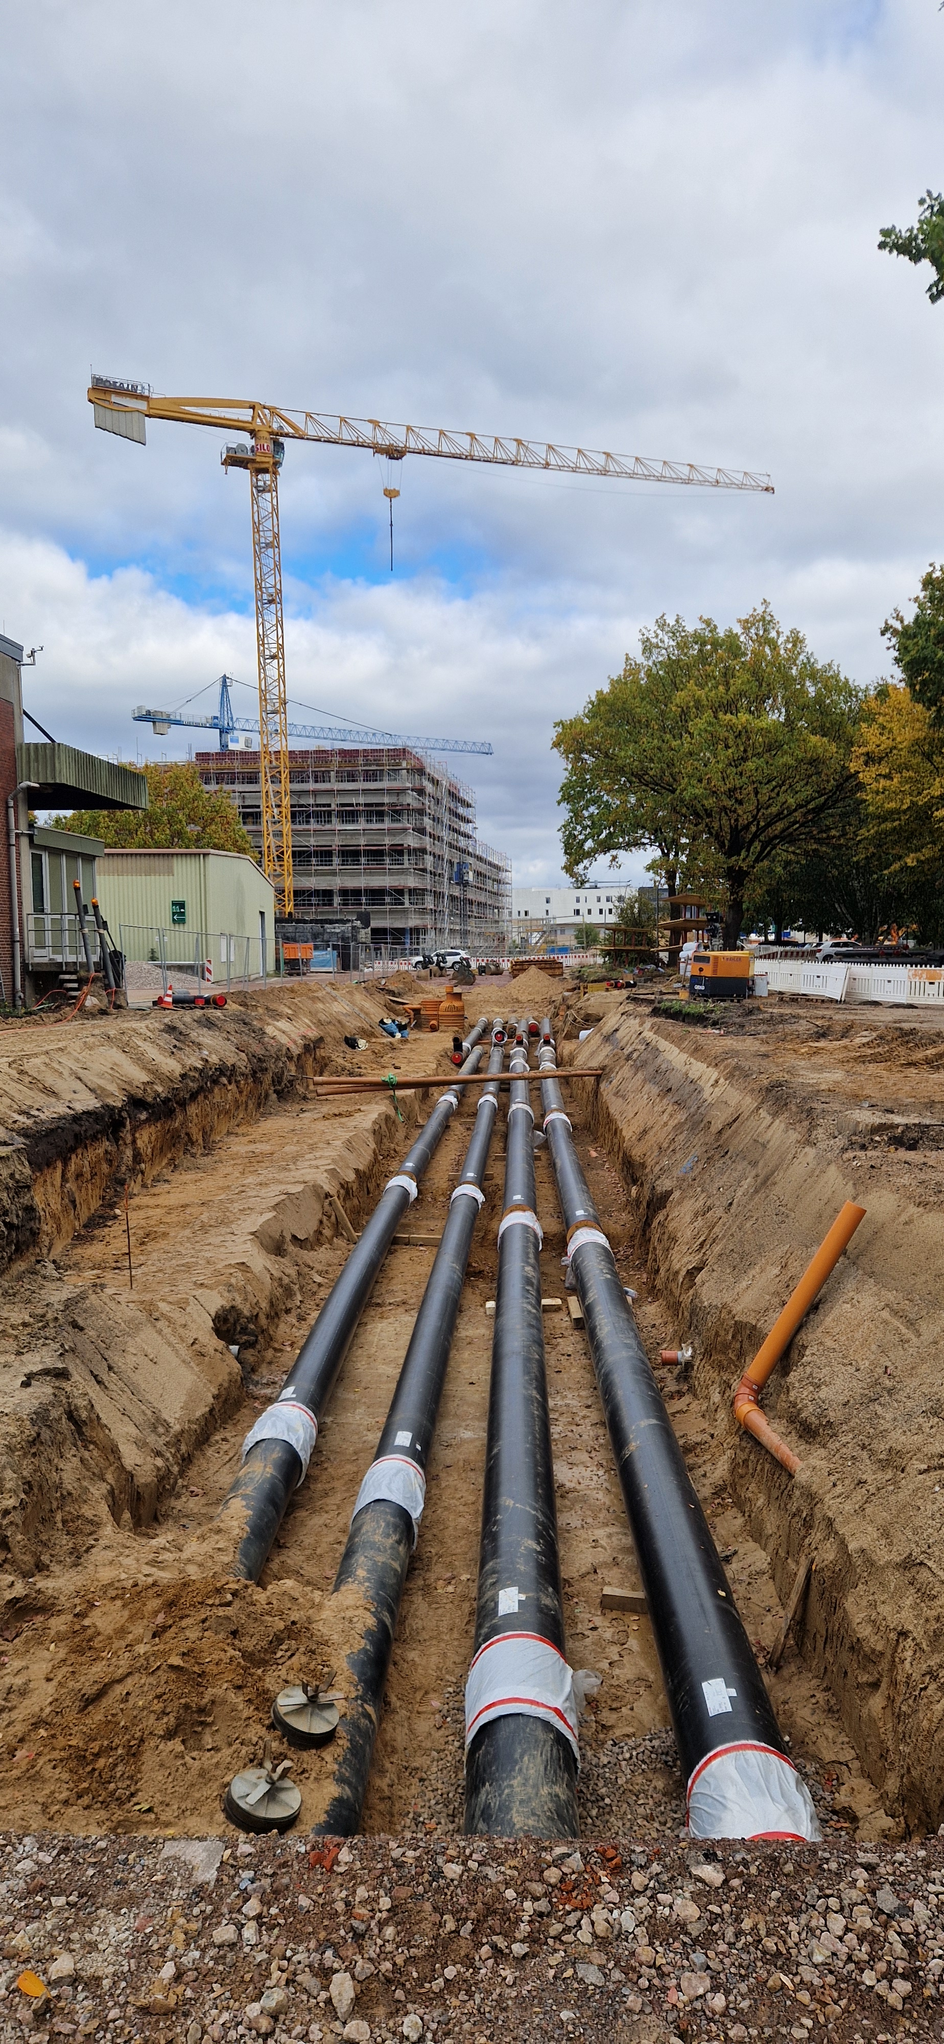
DESY campus = construction site

Slide 5

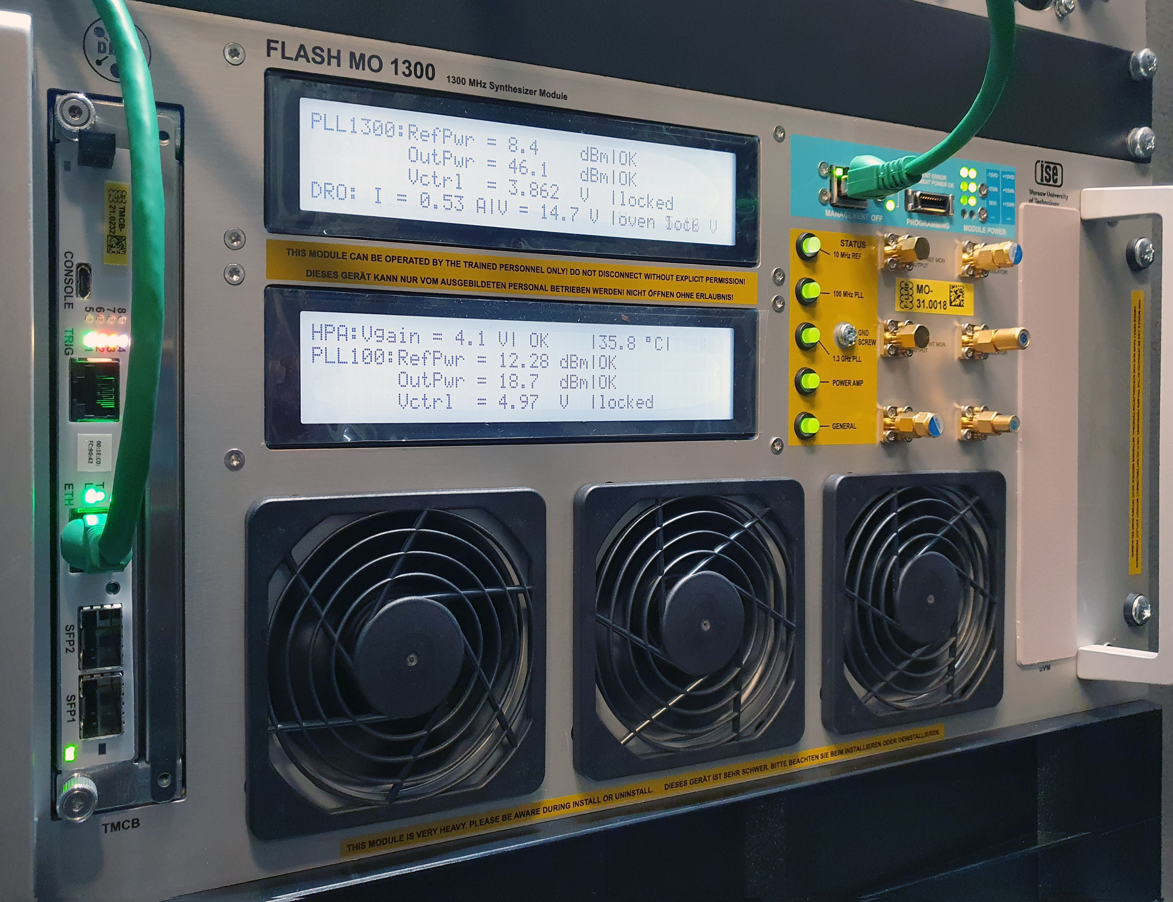

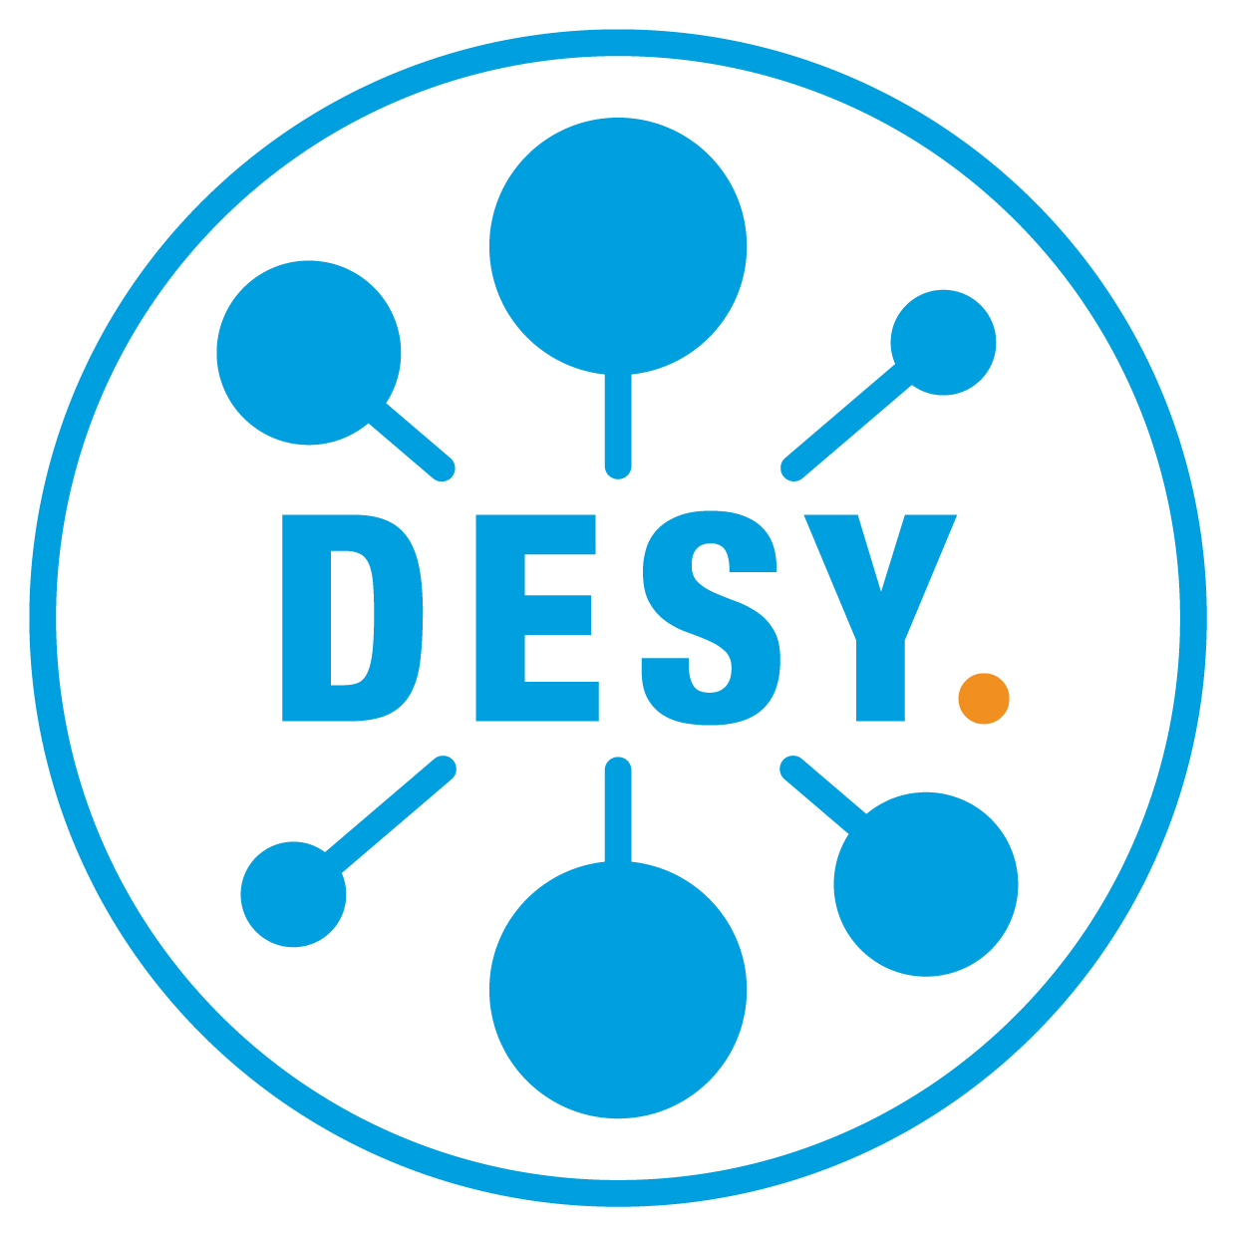

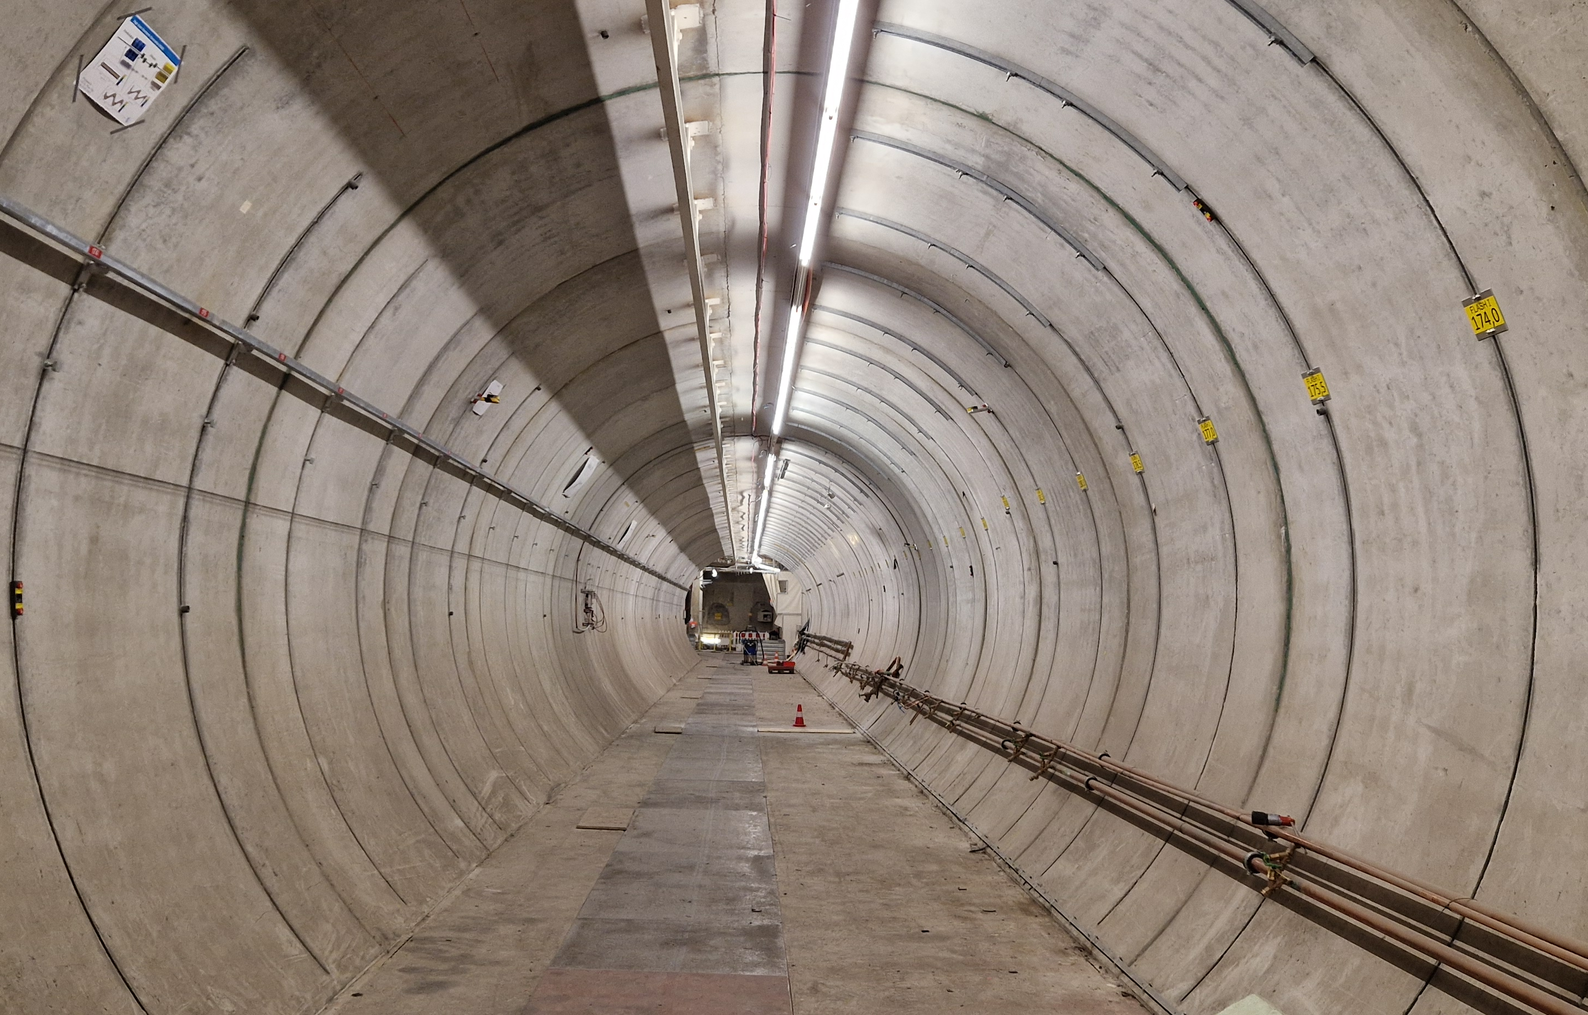
FLASH
Successive upgrades, back in operation since August 2025
2021 - 2022 shutdown (10 months)
ACC23 = 2 new cryomodules with cavities running on average at 28 – 29 MV/m
ACC45 optimized waveguide distribution
New energy 1.35 GeV
New main oscillator
2024 – 2025 shutdown (14 months)
photon beam line upgrade
variable gap + apple-X undulators (FLASH1 beamline)
new injector laser + provide external seeding
LLRF
modernizing legacy monitoring system (new racks, VME → MTCA)
improving RF reference distribution to bring benefit of new MO to end users
MO designed in collaboration with ISE, Poland licensed to KVG
Integrated jitter:
< 12 fs [10 Hz to 100 Hz]
< 1.8 fs [100 Hz to 1 kHz]
< 0.8 fs [1 kHz to 1 MHz]
Oct. 2024

Slide 6
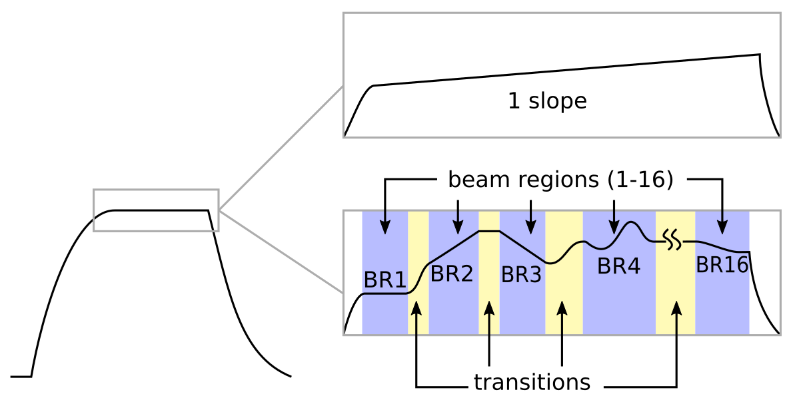
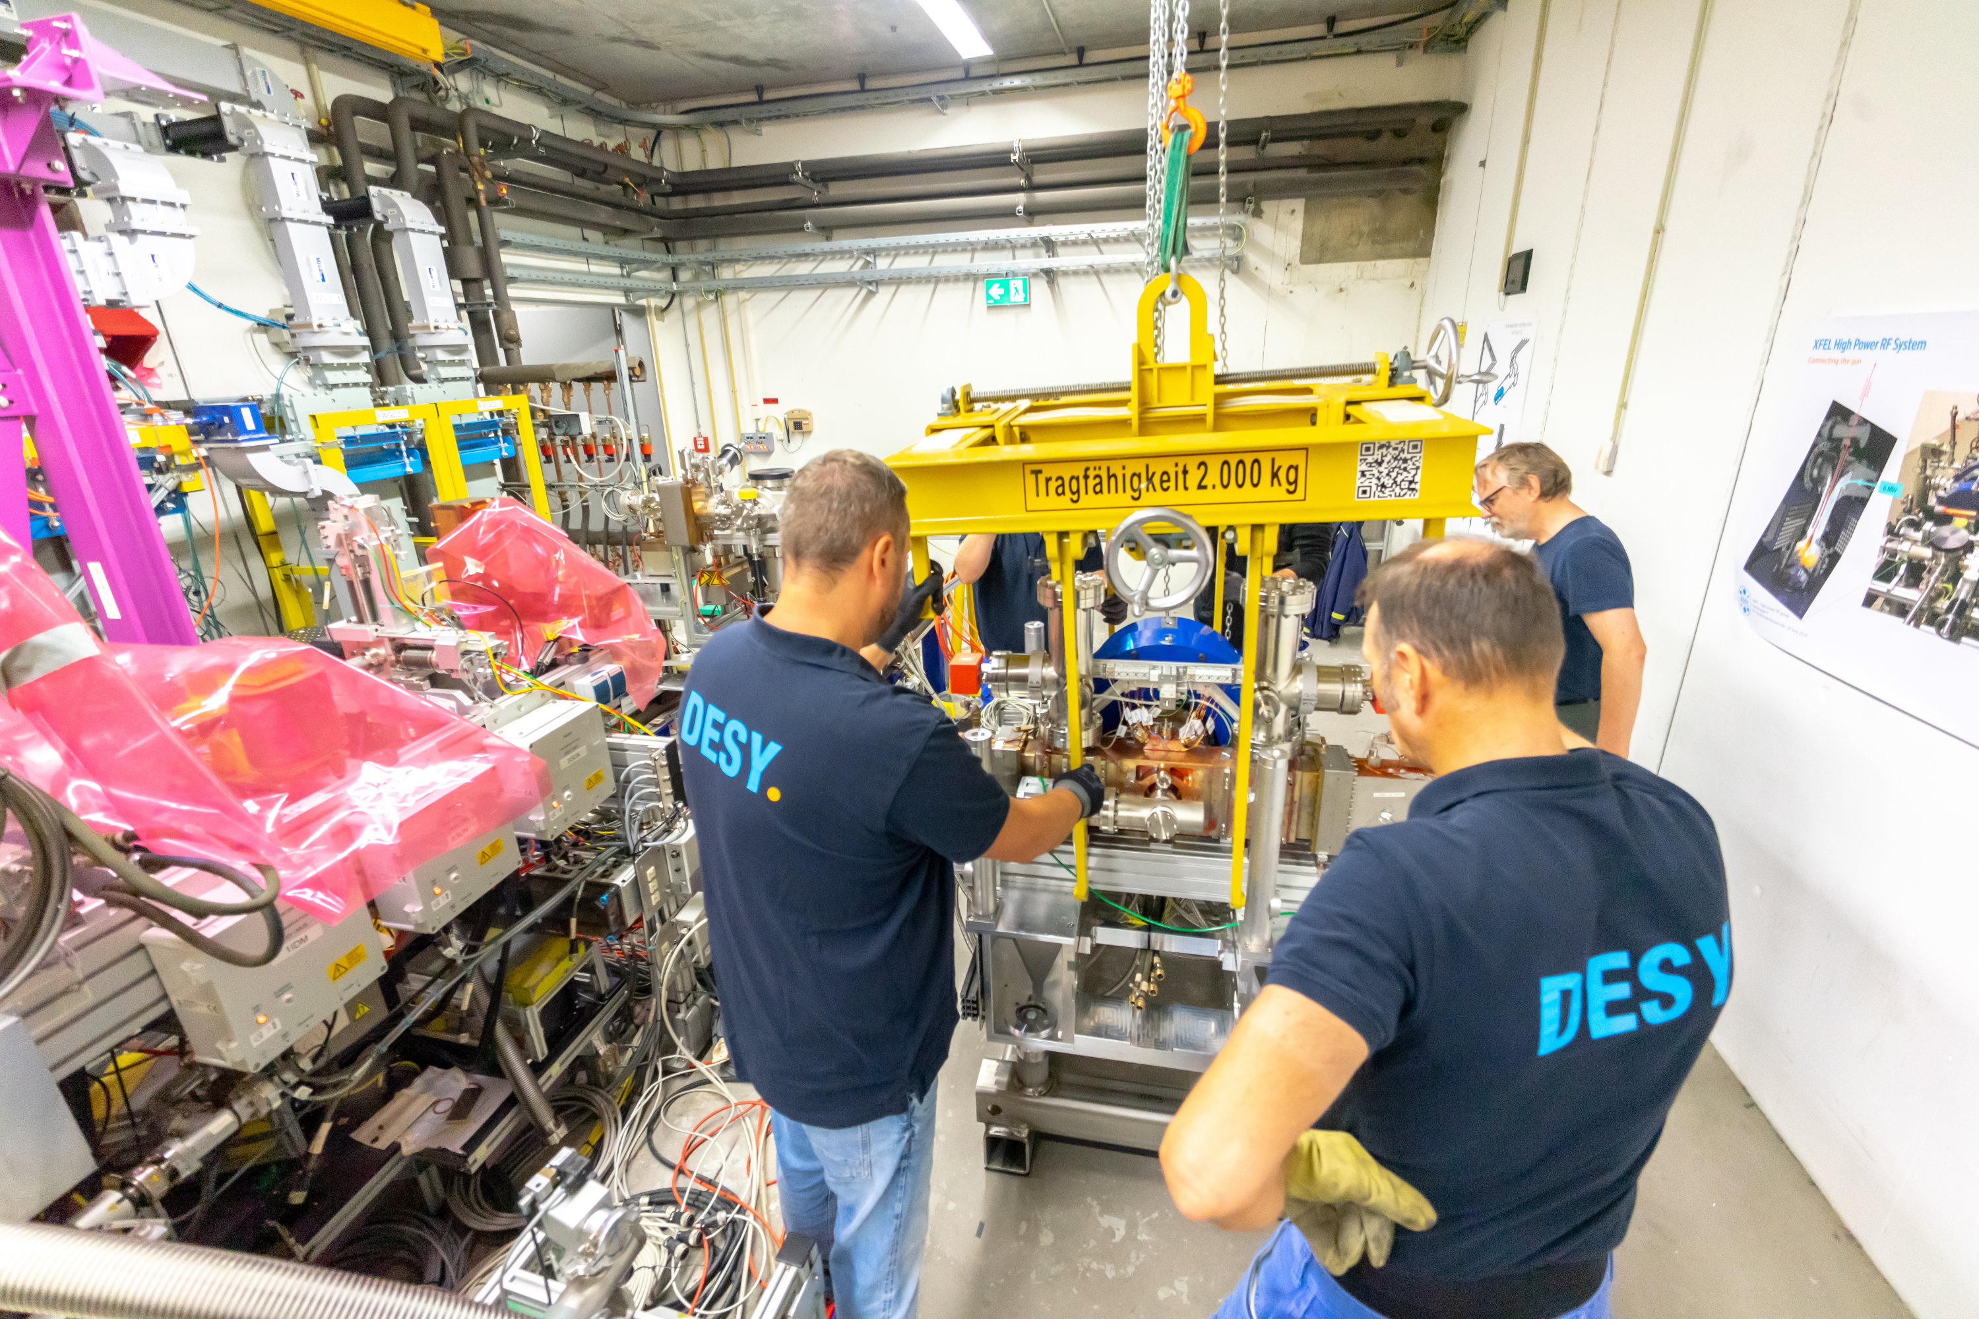
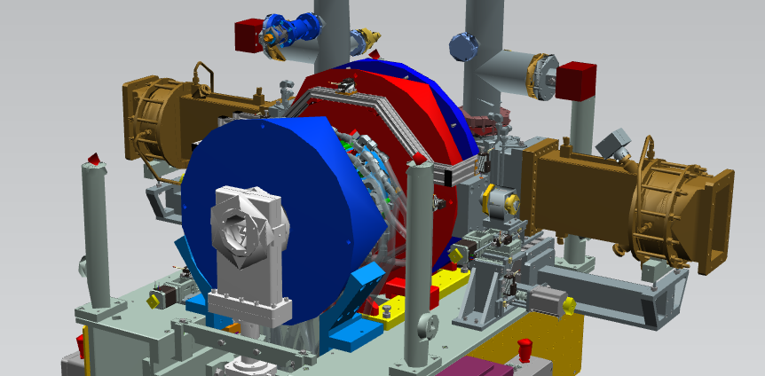
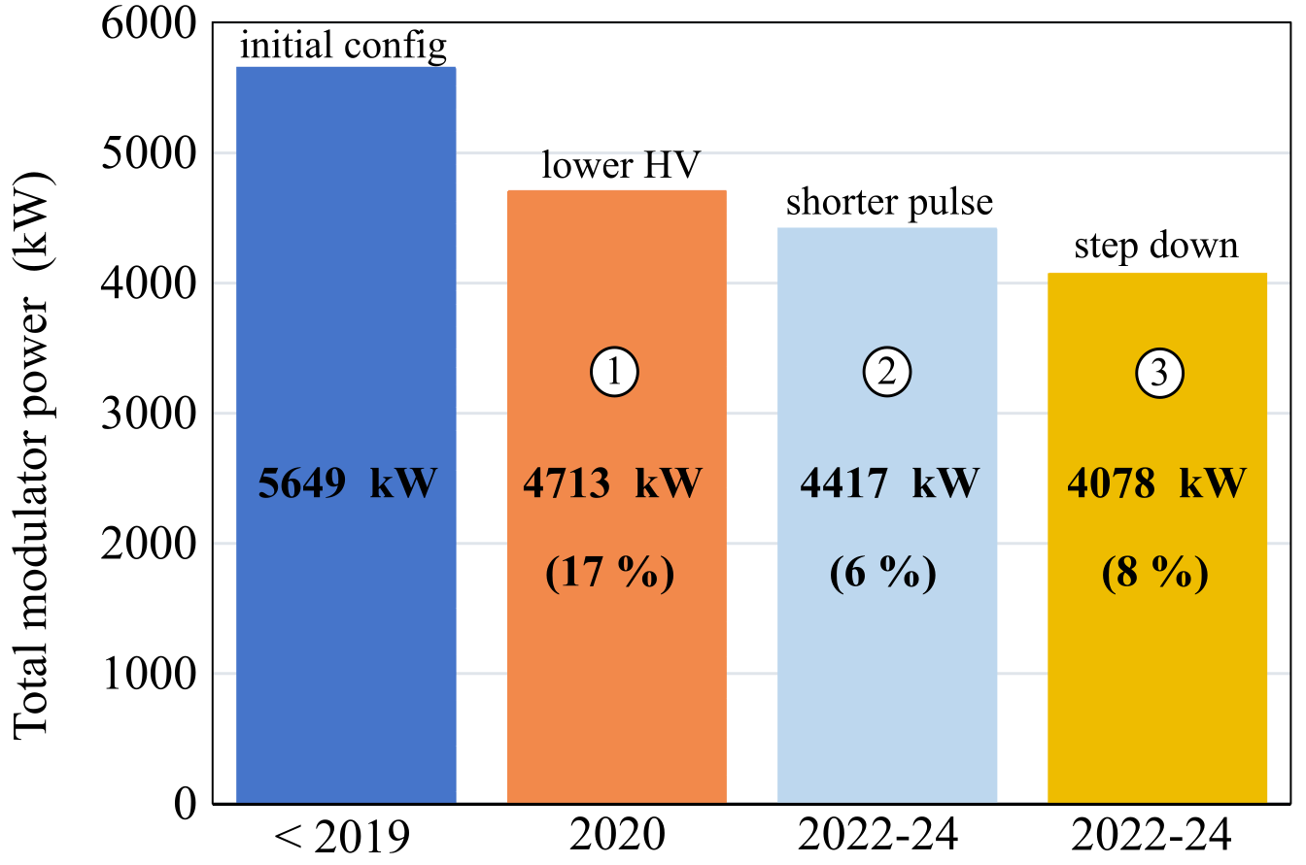
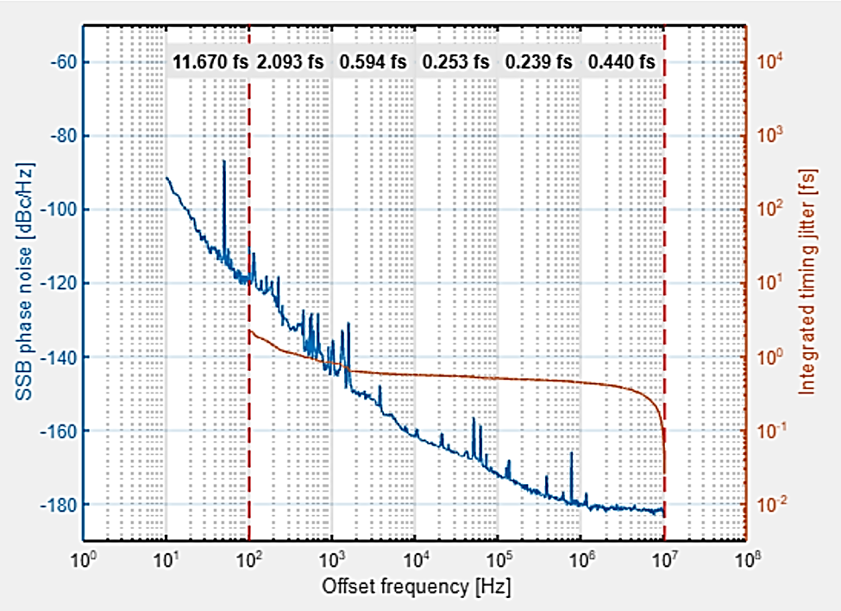
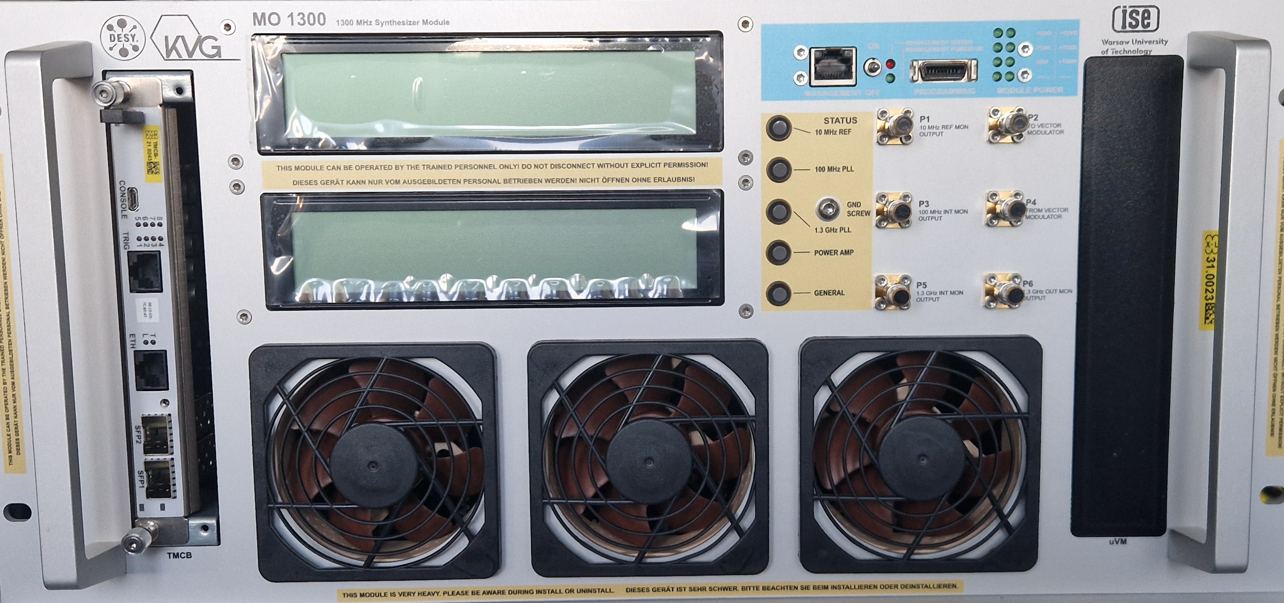
EuXFEL
Recent developments, currently shutdown (1st warmup since 2017 !), restart January 2026
beam regions
new RF gun
Gun5 installation at XFEL (Sept. 2025)
adapt LLRF to support any arbitrary setpoint waveform
adapt LLRF for 2 input ports and probe pick-up
energy savings
new MO
> 1 MW savings (Mio €)
Integrated jitter:
< 12 fs [10 Hz to 100 Hz]
< 2.1 fs [100 Hz to 1 kHz]
< 1.1 fs [1 kHz to 1 MHz]
adapt LLRF to compensate for HPRF non-linearities
benefit 1-to-1 from FLASH MO development

Slide 7

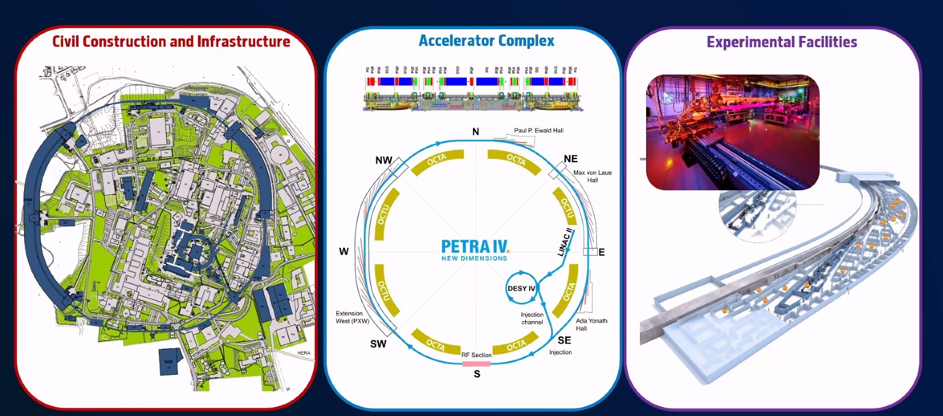
PETRA IV
PETRA III upgrade (construction phase 2029 – 2032)
Courtesy H. Reichert

Slide 8
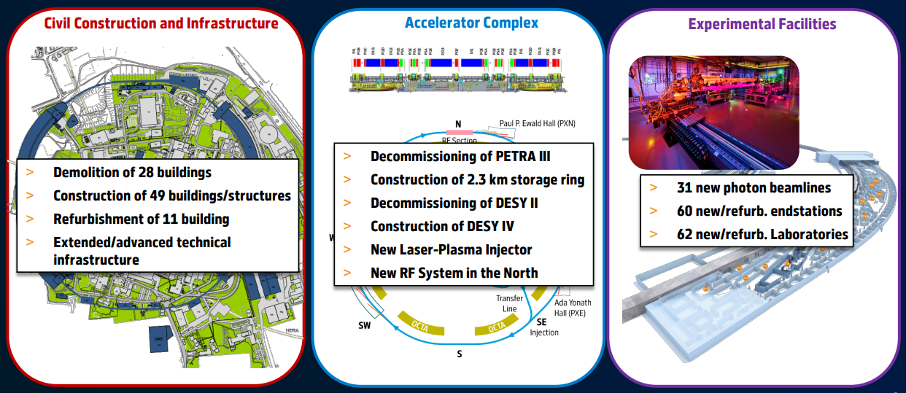
PETRA IV
PETRA III upgrade (construction phase 2029 – 2032)
Courtesy H. Reichert

Slide 9
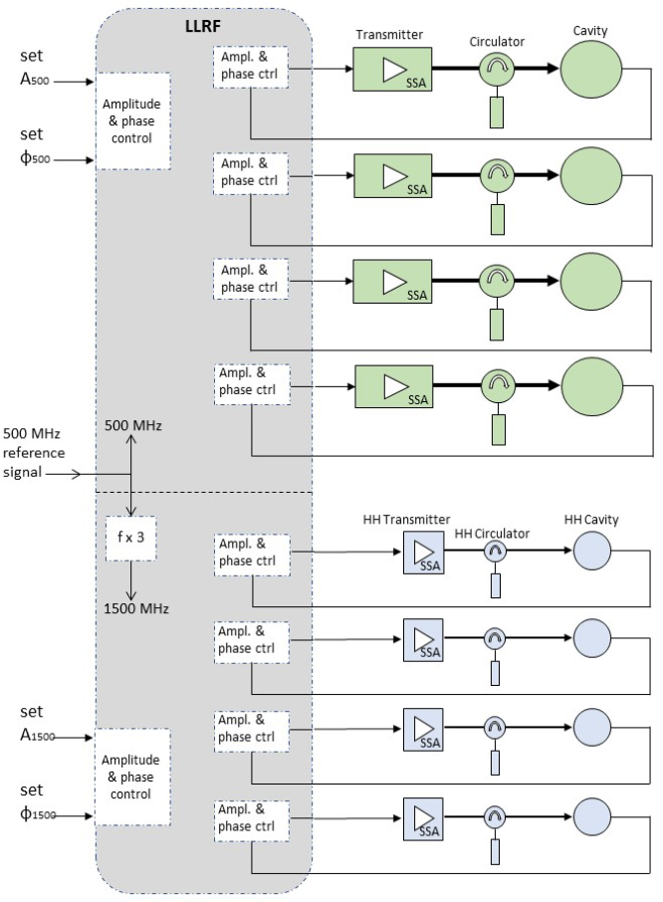
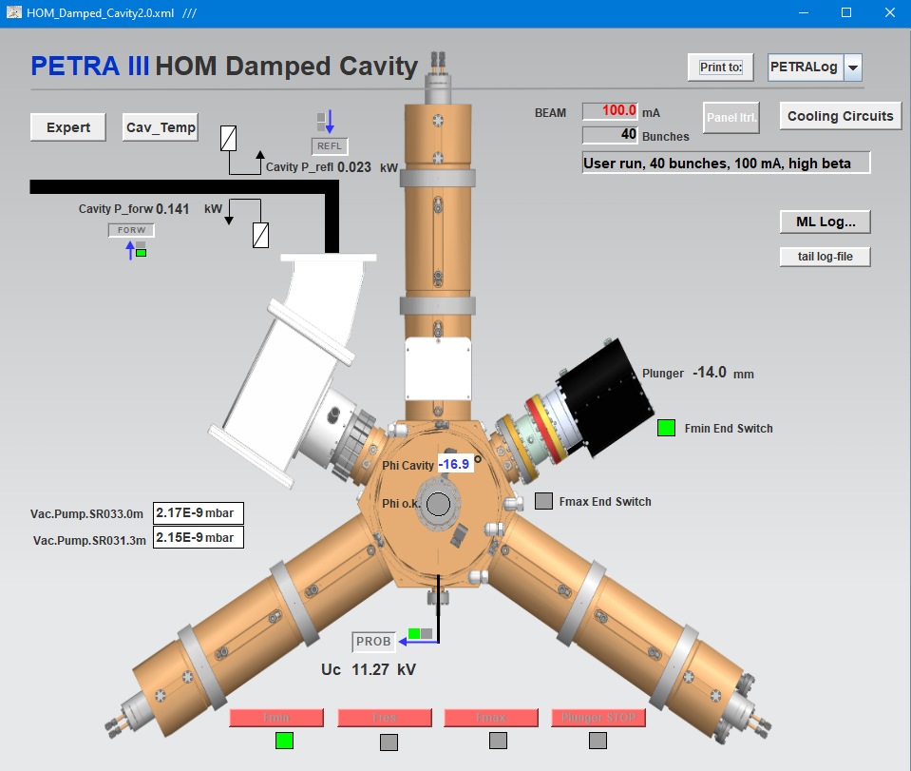
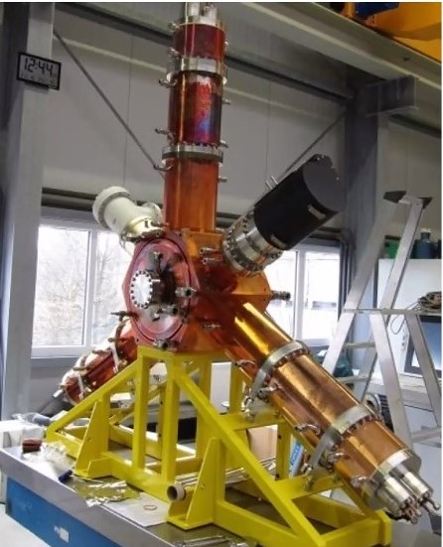
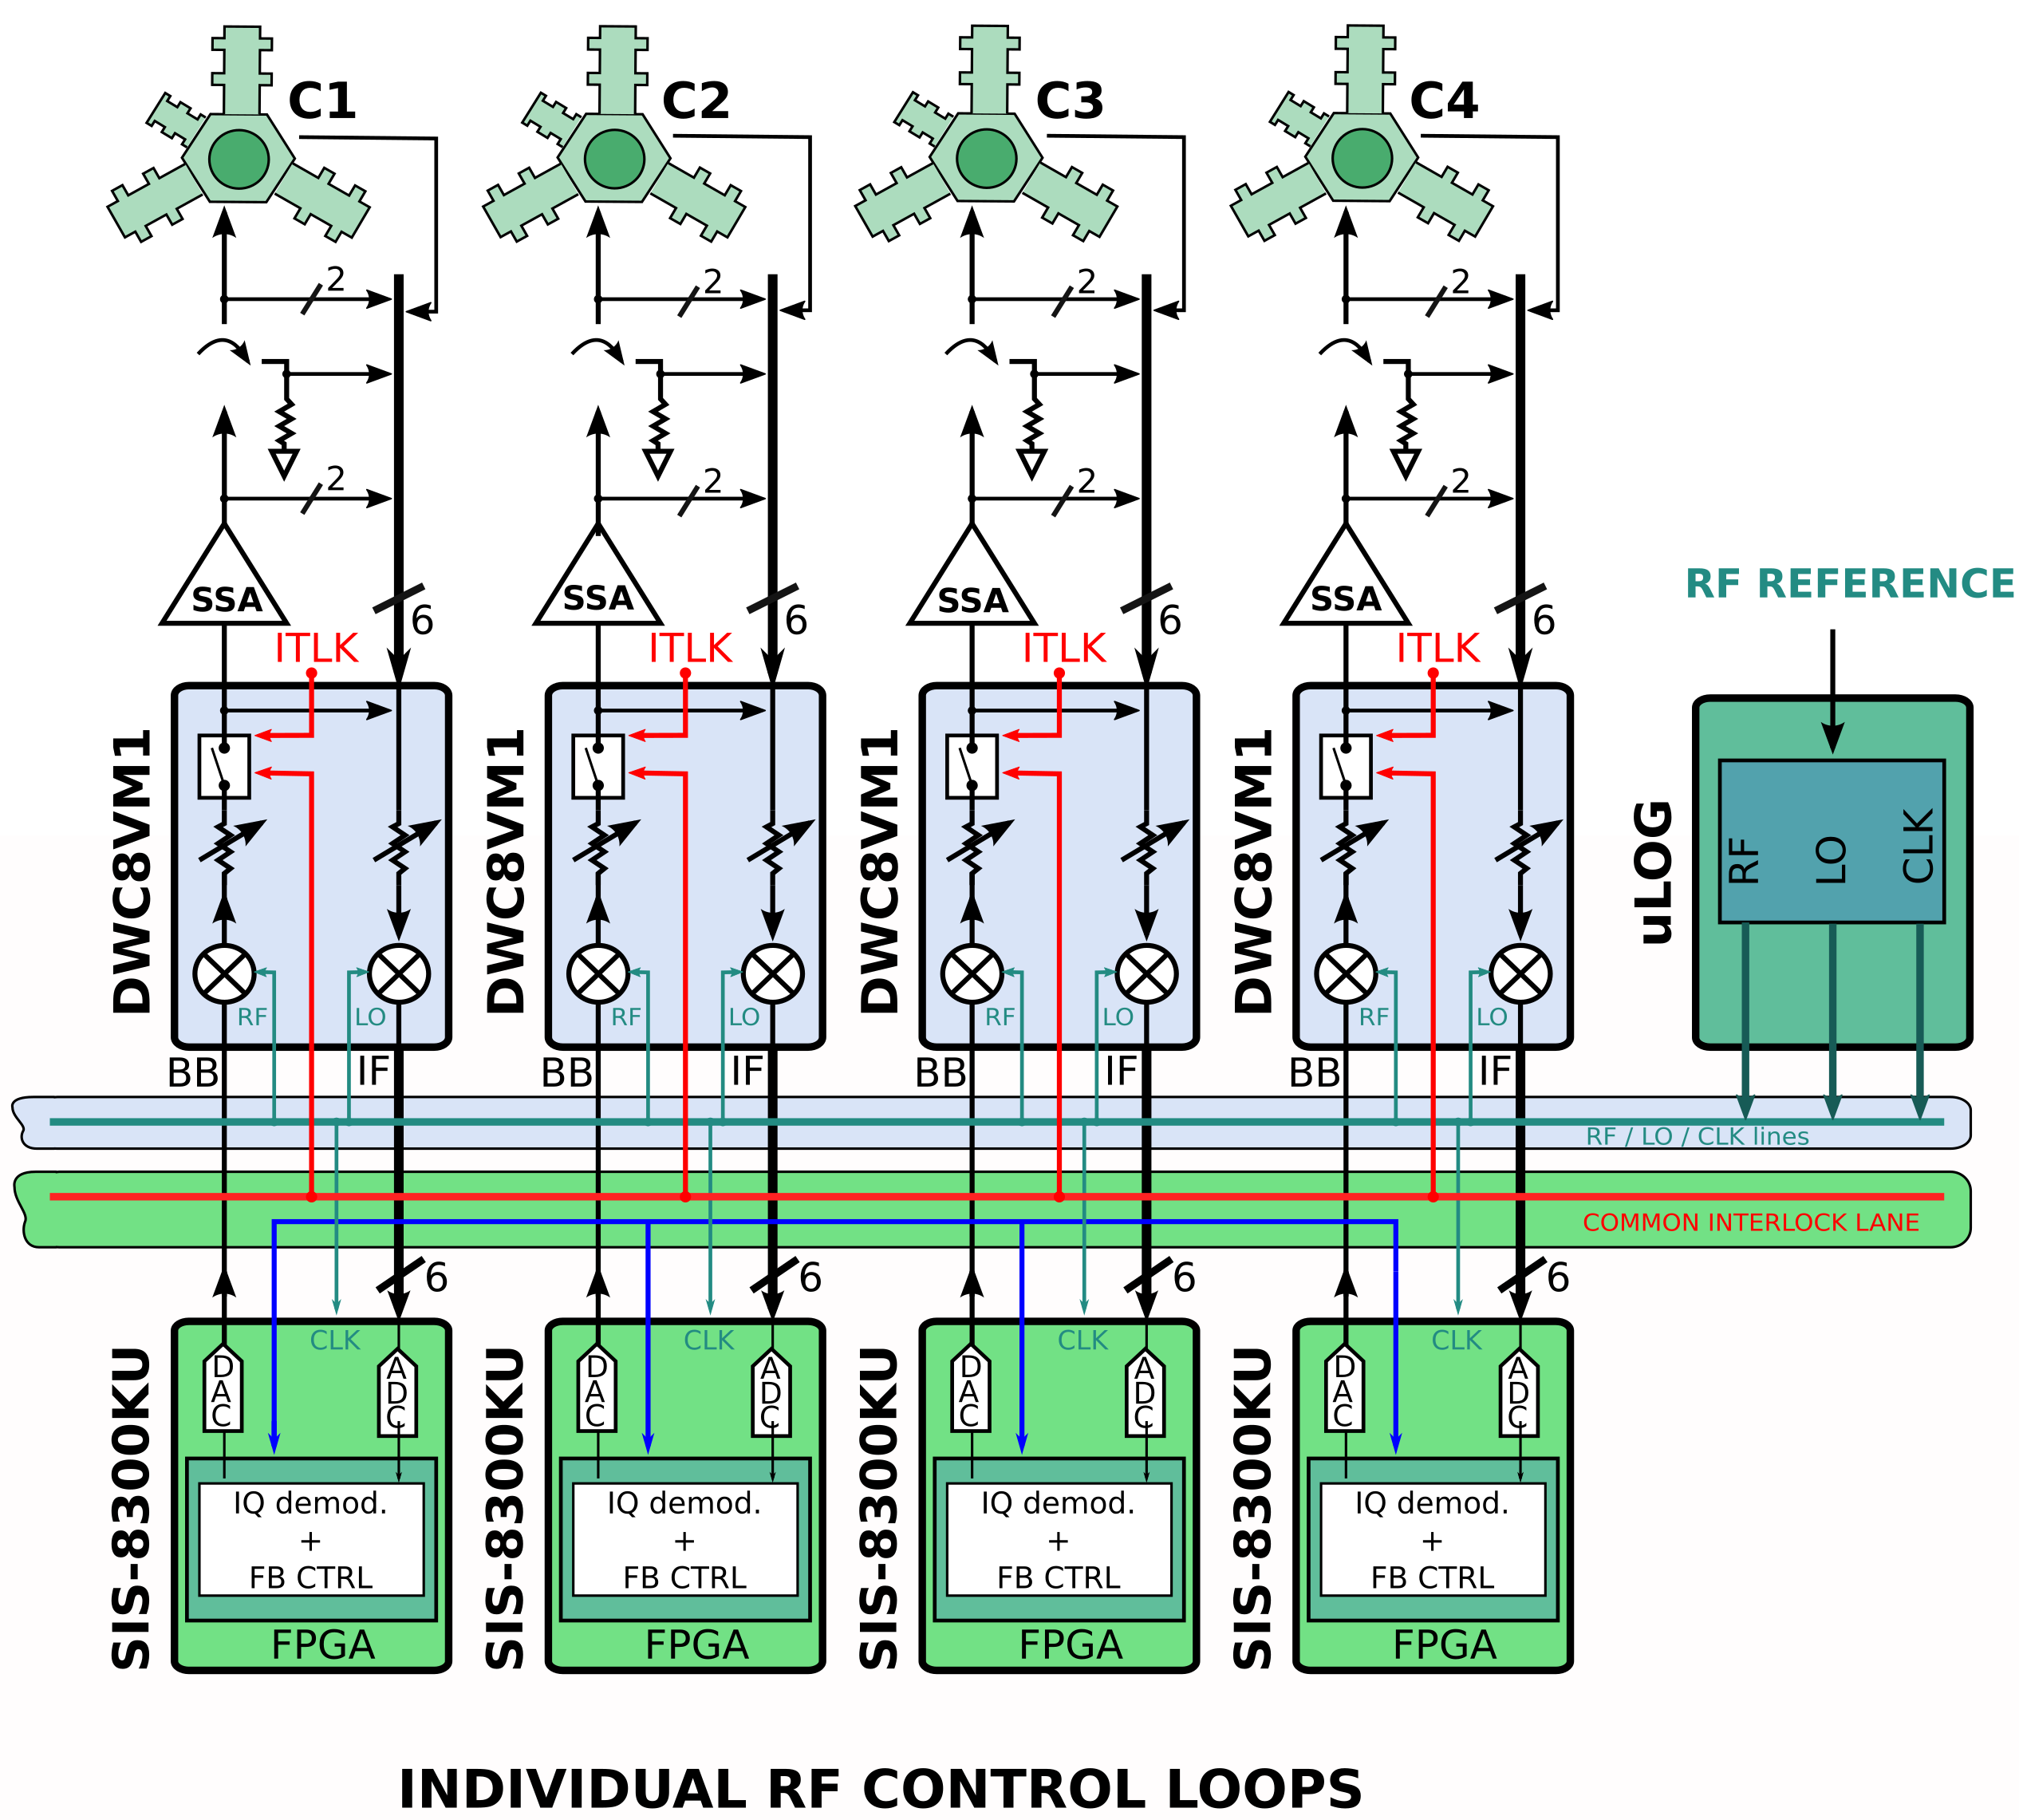
PETRA IV
PETRA III upgrade (construction phase 2029 – 2032)
6 groups of 4+4 single cavity controls
PETRA IV upgrade
Upgrade LLRF (MTCA.4-based)
24 cavities at 500 MHz each 80 kW SSA
24 cavities at 1.5 GHz each 10 kW SSA
Preparation
Test stand 500 MHz HOM-damped cavity installed and in operation at PETRA III with demons- -trator LLRF system
Hiring process
Courtesy N.O. Froehlich
MTCA.4 implementation

Slide 10
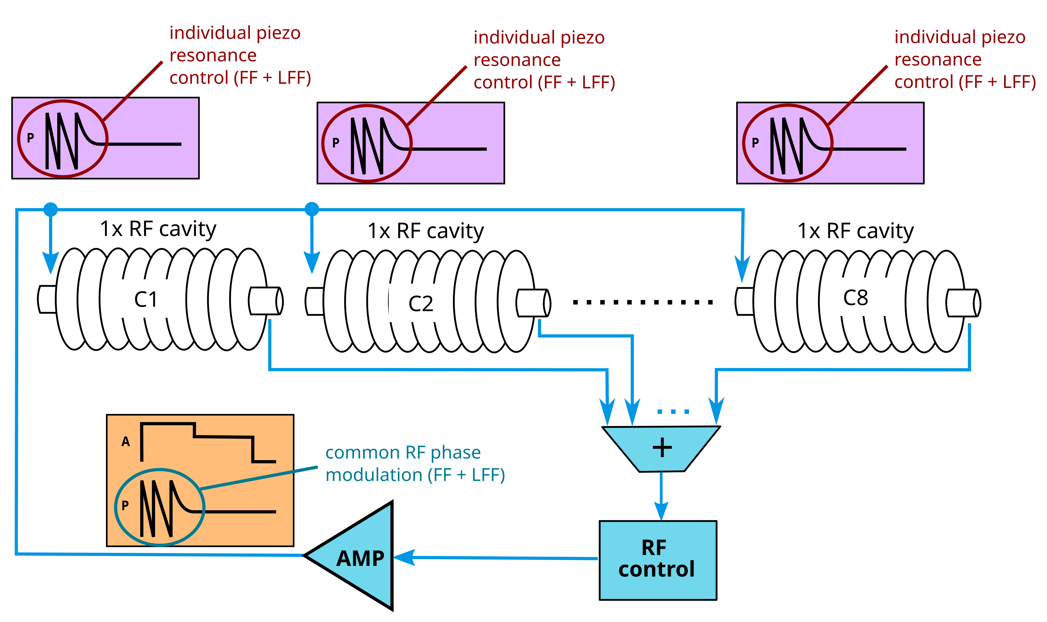
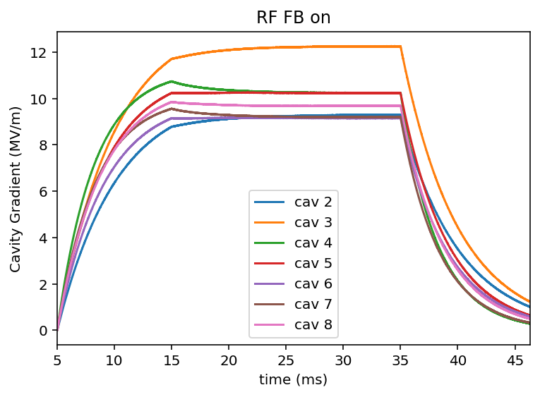
R&D
Preparation for the EuXFEL CW upgrade
Scope include CW and Long Pulse operation, referred to as High Duty Cycle (HDC)
distributed gradients ranges and Qext
worse case: Ecav = 18-20 MV/m, Qext = 6e7
expected microphonics ~ 3 Hz (rms)
LLRF control
preferred approach would be 1 SSPA / cavity
BUT
we might have to settle for vector sum control (8-16 cavities)
➔ Currently following both approaches
investigating common-mode RF and individual piezo control (resonant filling)
GDR
Qext = 1.5 – 2.1e7
Pout = 1.7 – 2.2 kW
Ecav = 9 – 10.5 MV/m
Observer-based detuning computation
Piezo adaptive FF
RF FB
preliminary results
piezo adaptive FF
See Bozo Richter’s poster Wed. afternoon “Resonant filling for long pulse operation of EuXFEL using iterative-based FF”
Courtesy B. Richter

Slide 11
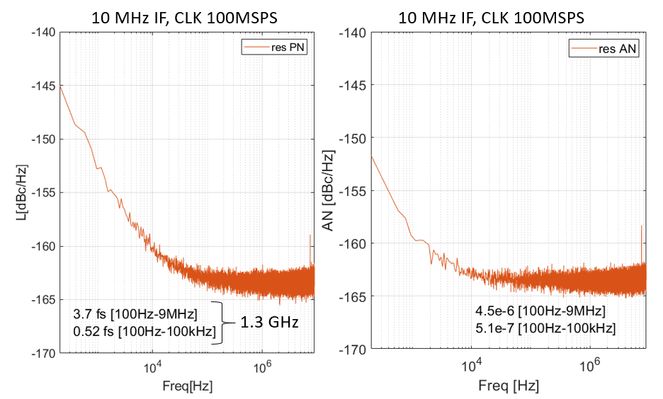
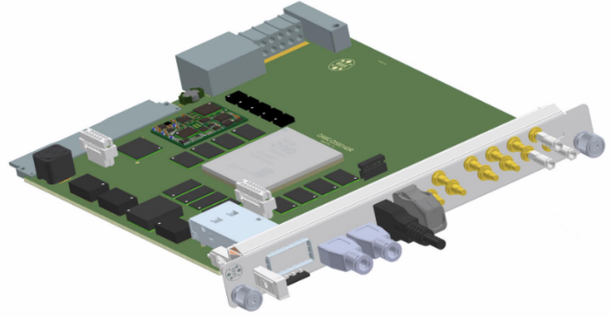



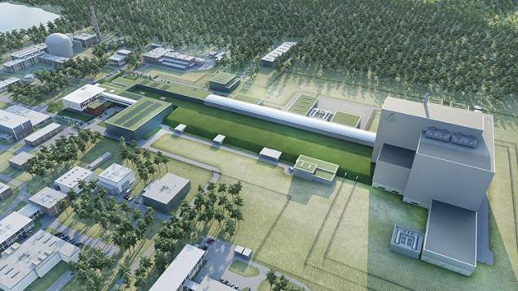
R&D
New MTCA developments for LLRF
SIS8310 (Struck) → next generation, high-precision ADC
Phase Noise: 0.52 fs [ 100 Hz – 100 kHz] Ampl. Noise: 5.1e-7 [ 100 Hz – 100 kHz]
Prototyping phase
Production planned for 2026
RFSoC
3rd gen. Zynq UltraScale+ (ZU47DR)
8x 14-bit ADCs at 5 GSPS
8x 14-bit DACs at 10 GBPS
PCIe gen 4 (front and rear)
First production batch Spring 2026
Applications
Beam diagnostics and fast orbit feedback for PETRA IV
LLRF for MYRRHA (accelerator-driven nuclear reactor in Belgium)
evaluation phase
evaluation phase
Courtesy U. Mavric
Courtesy B. Boghrati
image: https://www.sckcen.be/en

Slide 12
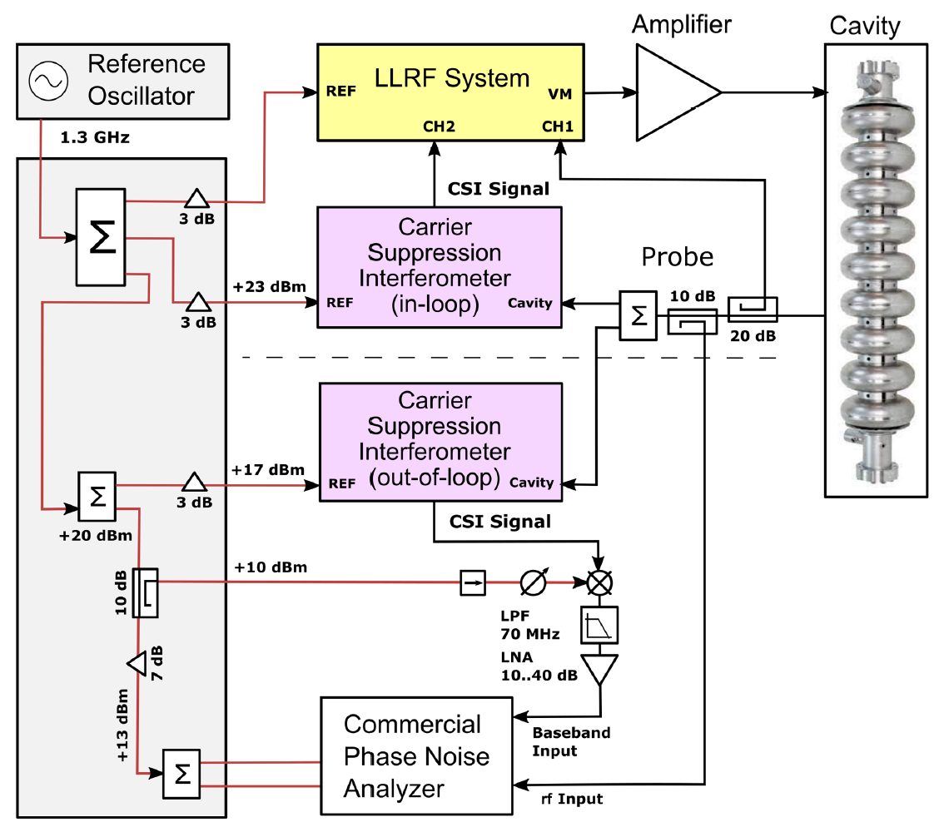
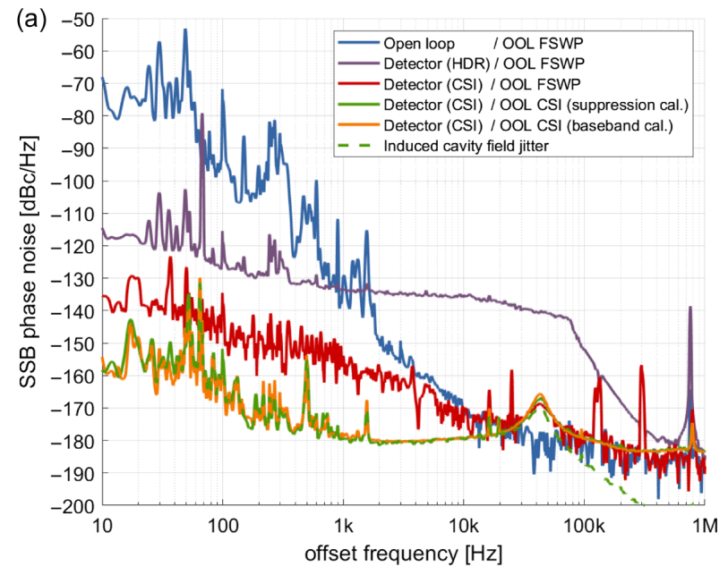
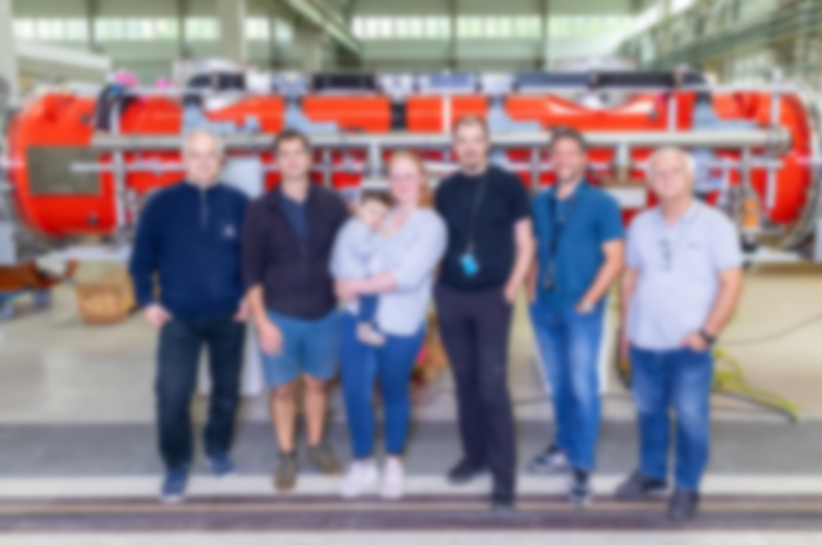
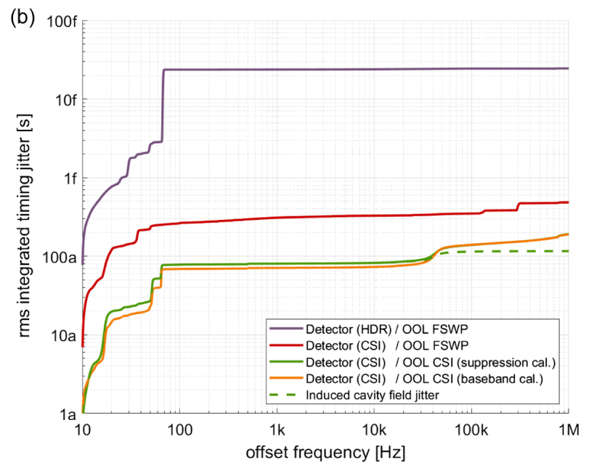

R&D
Integrate CSI (carrier suppression interferometer) to LLRF control
Carrier Suppression Interferometer
Demonstrated in the lab 60 dB noise floor improvement
Used in the LLRF detection chain
out-of-loop phase -160 to –180 dBc/Hz
100 as integrated jitter [10 Hz – 1 MHz]
L. Springer, et al. “Phase Noise Measurements for L-Band Applications at Attosecond Resolution” in IEEE Transactions on Instrumentation and Measurement, vol. 71, pp. 1-7, 2022, Art no. 8003307, doi: 10.1109/TIM.2022.3170975
Courtesy M. Hoffmann
F. Ludwig, et al. “RF controls based on carrier suppression detection with attosecond resolution”, Phys. Rev. Accel. Beams 28, 072803 – Published 31 July, 2025

Slide 13

Summary : Projects Roadmap
2025 2026 2027 2028 2029 2030 2031 2032 2033 2034 2035 2036
operation
LIMP
operation
shutdown
XFEL
HDC
XFEL
(HDC upgrade)
FOS
CDR
approval
Construction
FLASH
2020+
operation
…?
PETRA IV
TDR
preparation
+LINAC II
construction
operation
+DESY IV
~HDC R&D
innovate for sustainable accelerator system European-funded project focused on efficiency and sustainability of accelerator systems
iSAS
deliverables

Slide 14
References
1.3 GHz master oscillator, developed by DESY / ISE, licensed to KVG GmbH
https://kvg-gmbh.de/product/main-oscillator/
J. Branlard et al. “RF-based energy savings at the FLASH and European XFEL linacs”, in Proc. LINAC'24, Chicago, IL, USA, Aug. 2024, pp. 591-595. doi:10.18429/JACoW-LINAC2024-THZA003
L. Springer, et al. “Phase Noise Measurements for L-Band Applications at Attosecond Resolution” in IEEE Transactions on Instrumentation and Measurement, vol. 71, pp. 1-7, 2022, Art no. 8003307, doi: 10.1109/TIM.2022.3170975
F. Ludwig, et al. “RF controls based on carrier suppression detection with attosecond resolution”, Phys. Rev. Accel. Beams 28, 072803 – Published 31 July, 2025

Slide 15
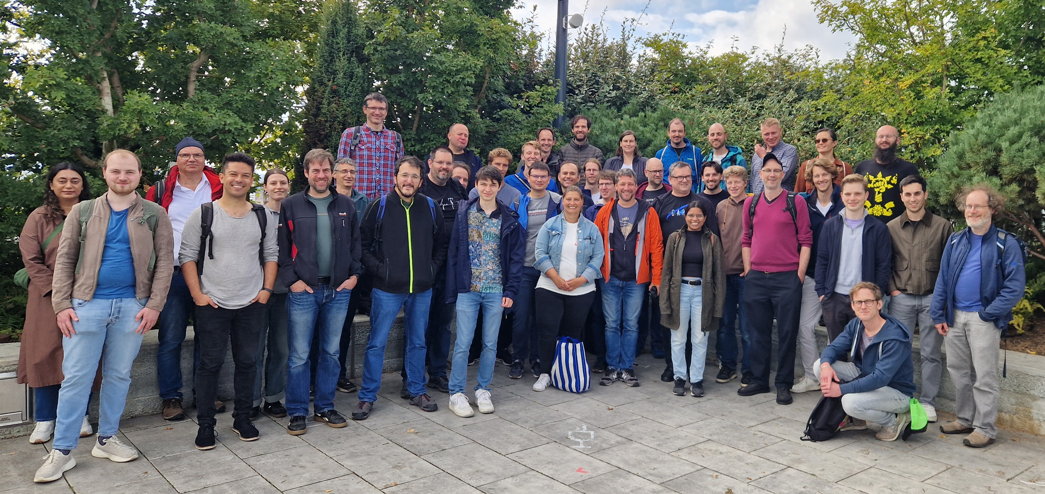
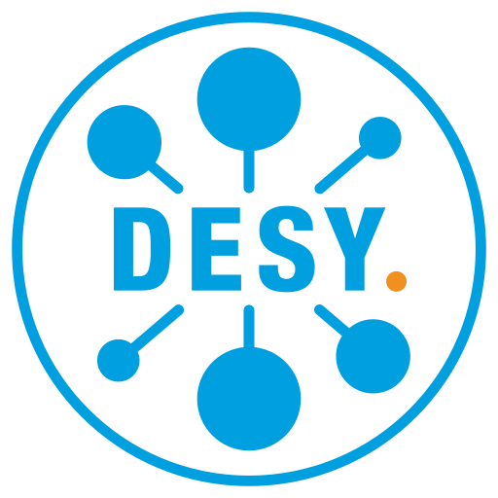

THANK YOU FOR YOUR ATTENTION !
MSK : group outing Sept. 2025
Julien Branlard
MSK
julien.branlard@desy.de
+49 (0)40 8998 1599
Contact
Deutsches
Elektronen-Synchrotron
www.desy.de

Slide 16
BACKUP SLIDES

Slide 17
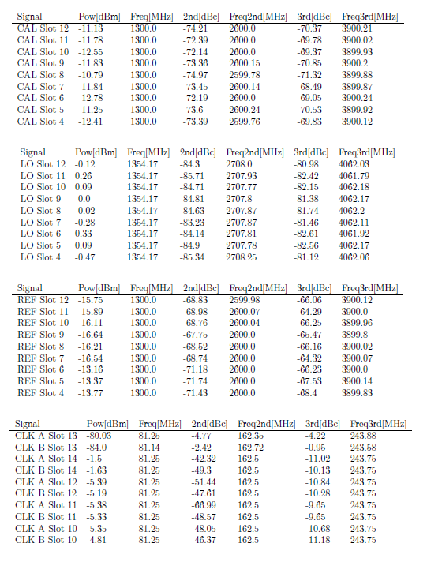
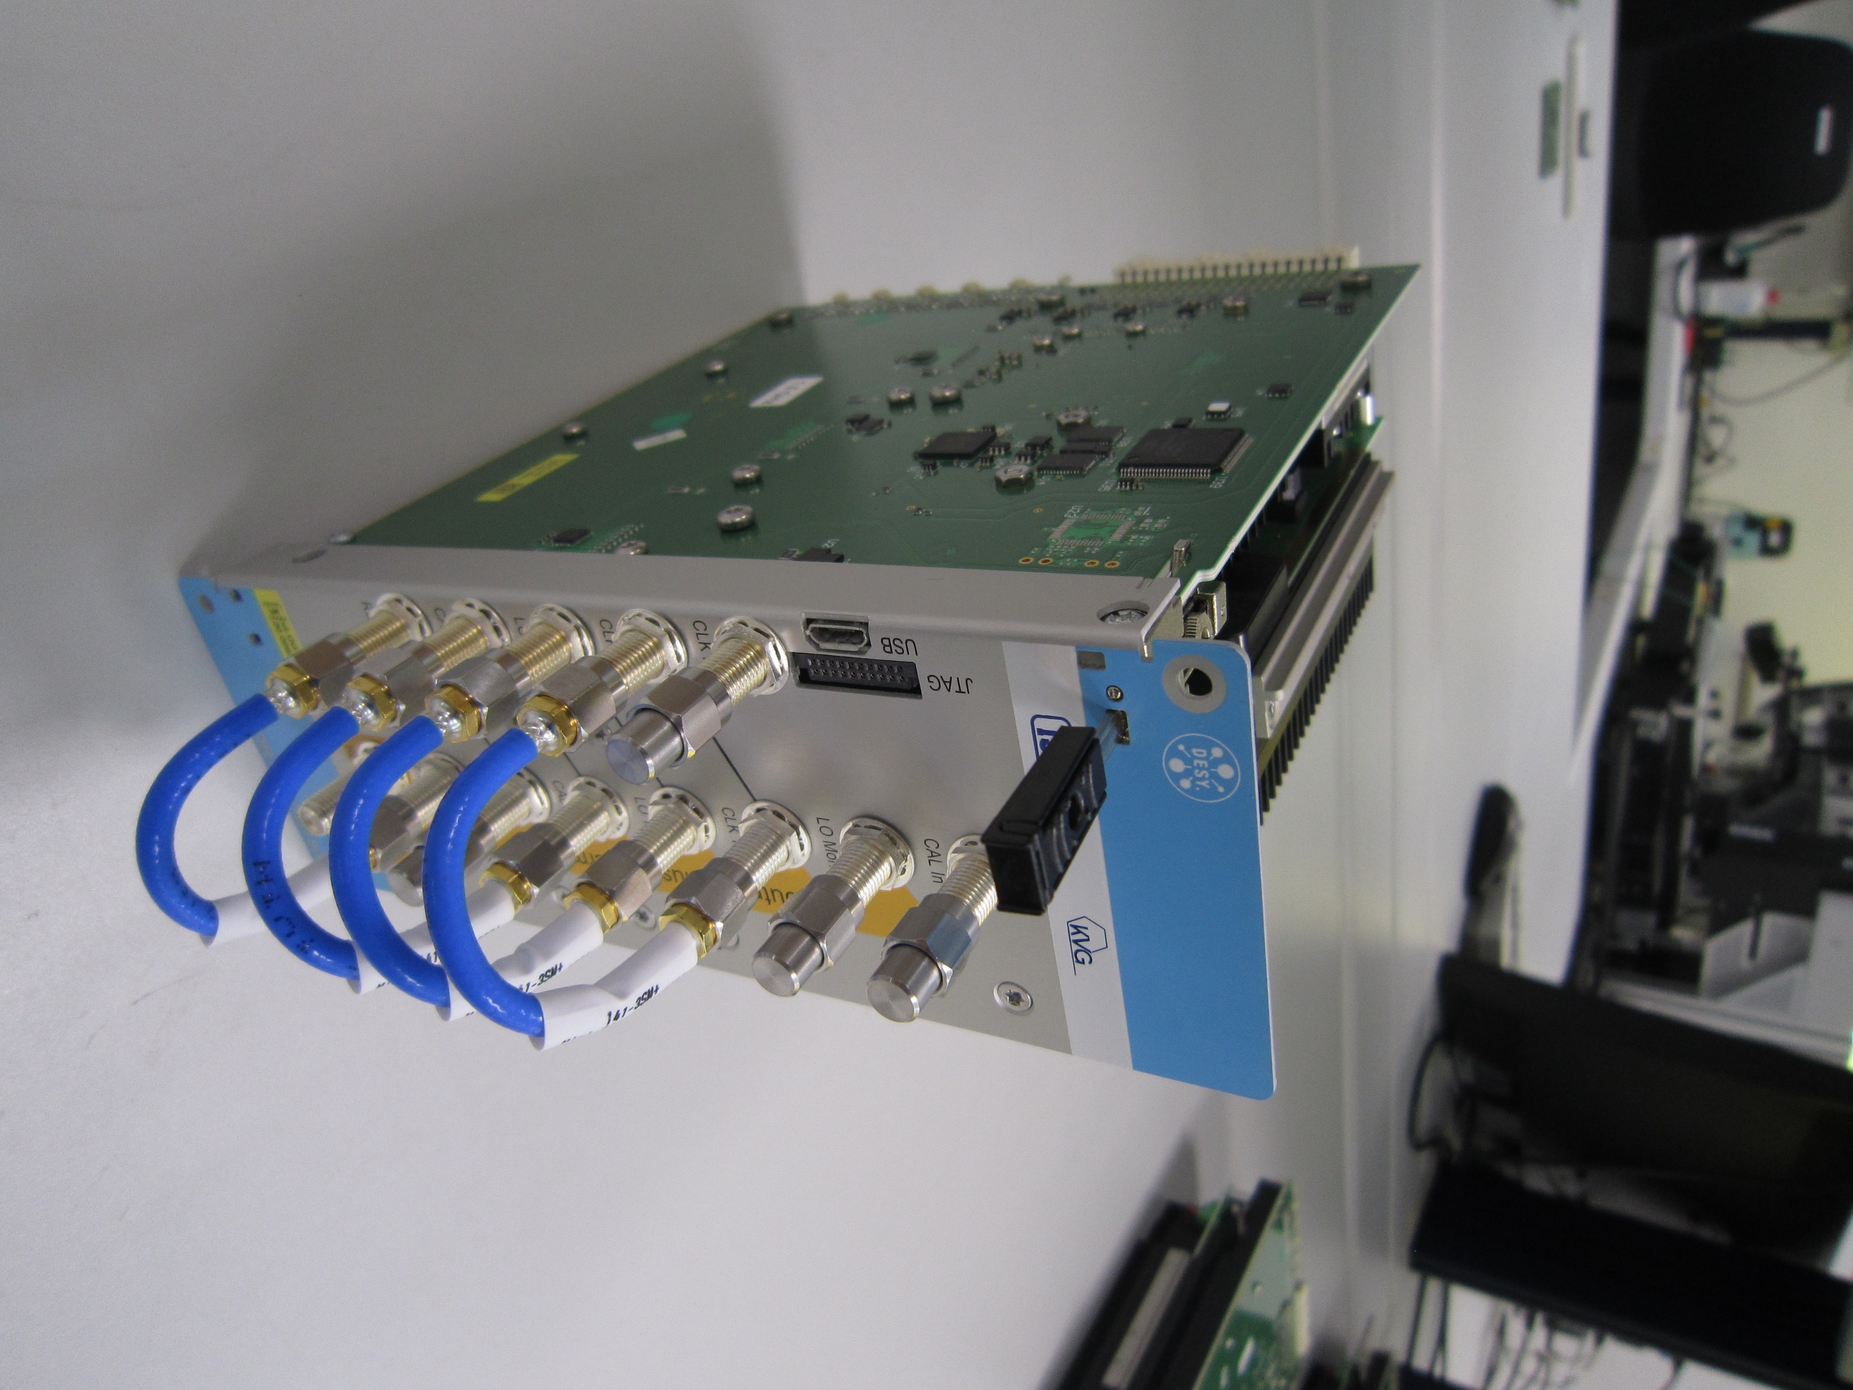
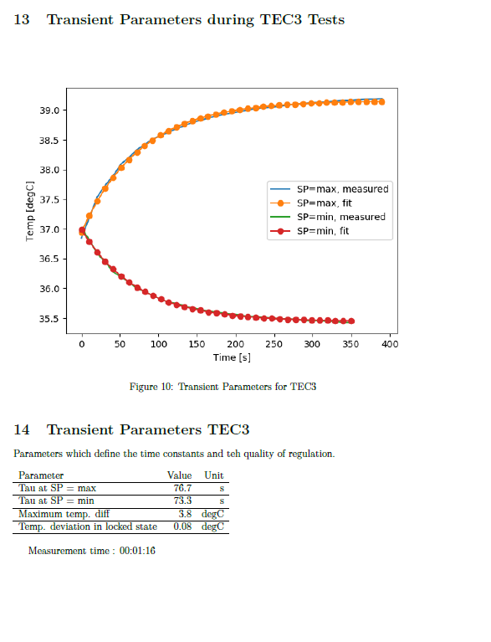
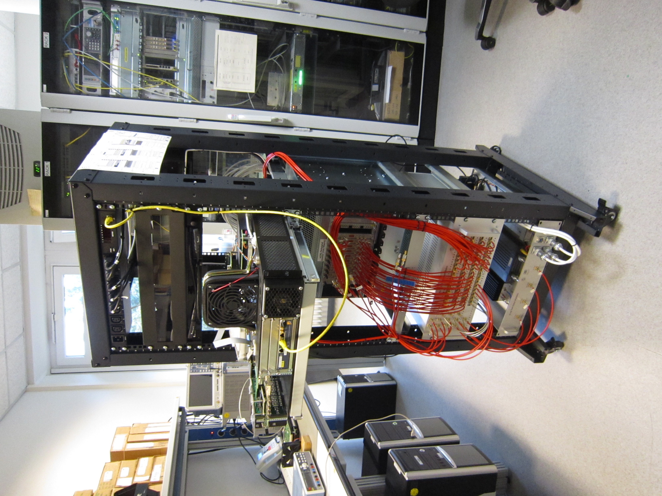
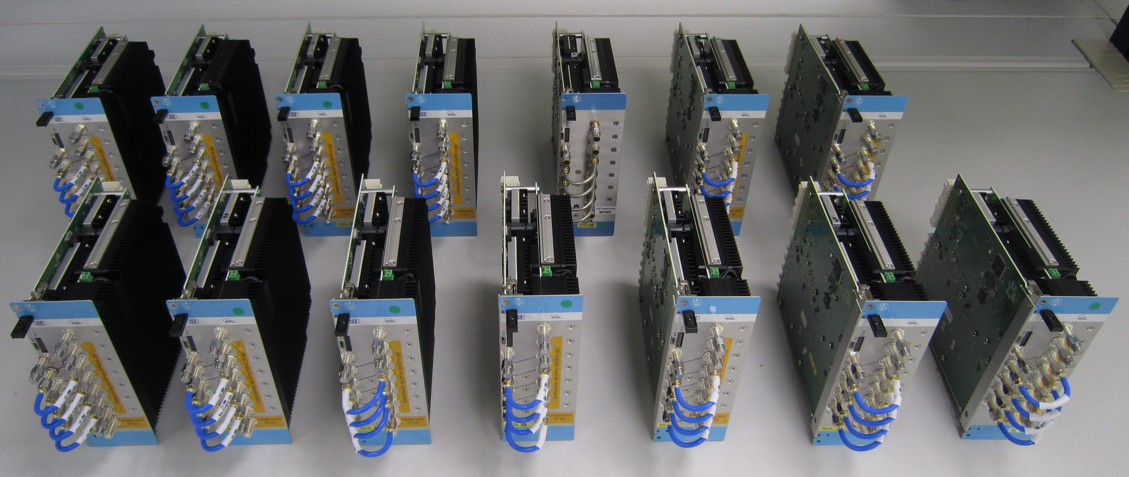
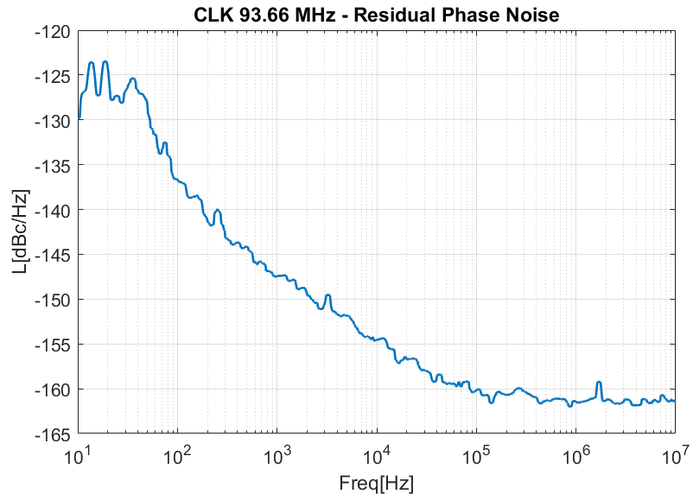
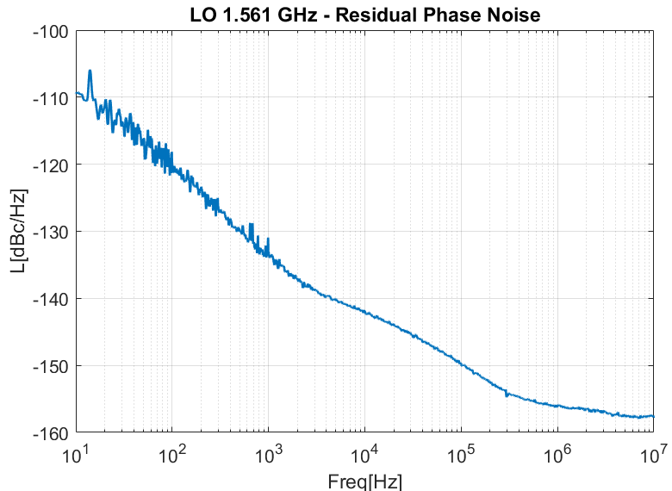
R&D
uLOG LO + REFER distribution board (uLOG)
DESY licensed production to company KVG GmbH
Series production at 1.3 GHz and 1.5 GHz
Production test stand to test each subcomponents

Slide 18
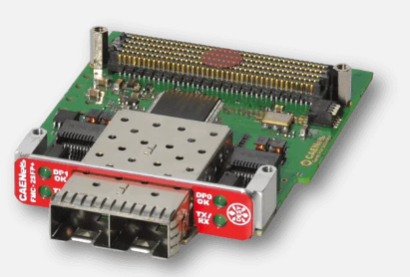
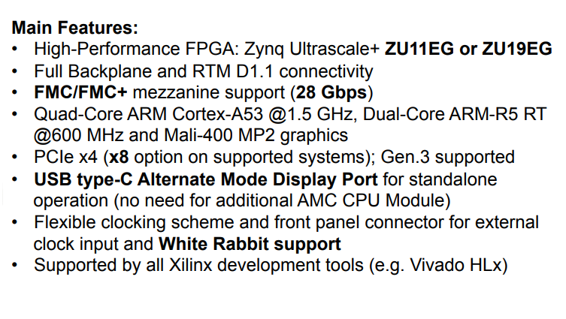
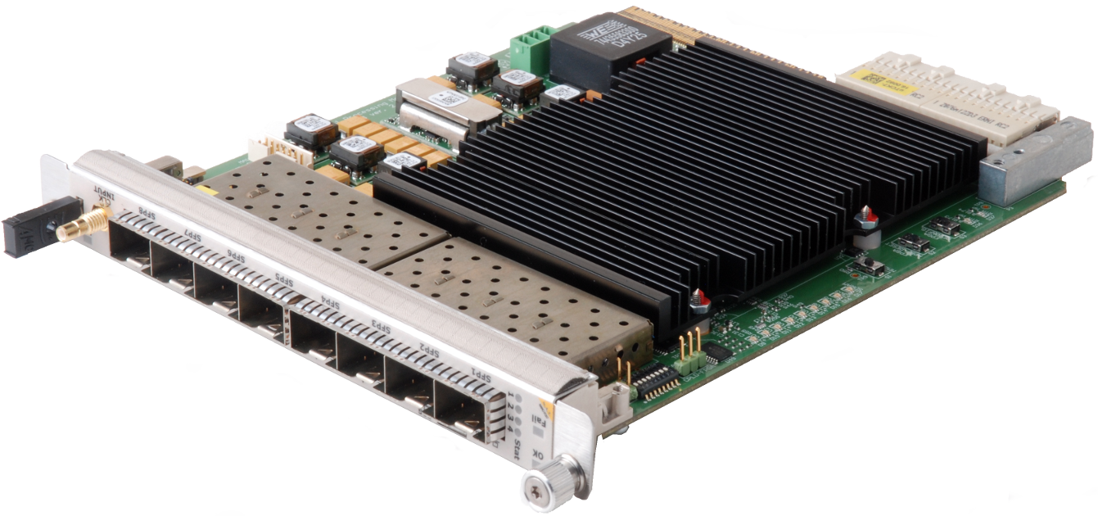
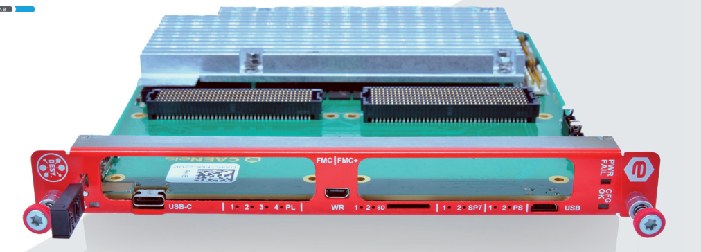
R&D
New MTCA developments for LLRF
ZUP + 2x FMC
TCK7 → FMC2ZUP
SIS8300 → SIS3rd generation ADC
uLOG → uLOG next generation
DESY licensed production to company KVG GmbH
Production of 10x 1.3 GHz and 3x 1.5 GHz modules (HZB)
Development of test stand to test each subcomponents
TCK7
Courtesy Uros Mavric

Slide 19



R&D
Continuous wave (CW) and Long Pulse (LP) R&D at XFEL
Two CW-capable tests stands
Test of 3.9 GHz in CW at XATB1 (SSA)
Test of 1.3 GHz in CW/LP at CMTB (IOT)
Development of a waveguide Q-tuner : goal is to extend Q_{L} tuning range (up to 1e8) w/o changing cryomodules
Dynamic heat load measurement as a function of duty cycle
CW test with 3.9 GHz module in XATB1
CW tests with 1.3 GHz module in CMTB

Slide 20



R&D for the HDC upgrade
Understanding efficiency optimization and maximum beam energy vs cryo capacity
Extending external coupler (Qext) range
Establishing the maximum dynamic heat load
Assessing limit with heaters, with CW RF, at the cavity level, at cryomodule level
Current max Qext = 1e7
Possible HDC Qext = 5e7
Waveguide Q-tuner offers a factor 10 increase in Qext
90W
14
80W
12
10
70W
8
60W
Qext scale (a.u.)
6
50W
4
meas.
40W
2
simul.
3020W
0
unstable operation
0 10 40 60 80 100
20W
Motor position (%)
10W
Time
Major impact on efficiency of the accelerator
Major impact on the maximum beam energy

Slide 21




R&D for the HDC upgrade
RF source options and thermal impact on input couplers
Investigating RF source options
Assessing coupler heating
Assessing limit of coupler heating when operating in CW
Consider max power, efficiency, foot print, noise performance, cooling, etc..
4 kW SSA in AMTF
40 kW IOT in CMTB
XM46.1
Pin = 3 kW

Slide 22





R&D
Continuous wave (CW) and Long Pulse (LP) R&D at XFEL
XFEL : can we increase the current 1.3 msec pulse to 2, 3 ms without changing the hardware ?
Pulse stretching (affects read / write tables)
Affects diagnostics (detuning, performance computation etc…)
Tests at XFEL
T_{beam} = 650 usec
T_{beam} = 1000 usec
Sept 2021 : longer beam time by shortening fill time and lowering Q_{L} (4.6e6 → 2.5e6)
Q_{L} = 4.6e6
T_{fill} = 750 usec
Q_{L} = 2.5e6
T_{fill} = 400 usec
A13 665 → 1000 usec flat top
March 2022 : longer beam time by using extended modulator pulse
A10 665 → 970 usec flat top

Slide 23





R&D
Gravitational waves
MAGO revival (Microwave Apparatus for Gravitational waves Observation)
Pick up MAGO project (from early 2000) driven by CERN at the time
Use binary cell SRF cavity as possible detector for gravitational waves
LLRF in SEL combined with CSI to improve SNR
LISA (Laser Interferometer Space Antenna)
Development of detector electronics (non-LLRF)
MAGO cavity at DESY
CSI setup
Courtesy Louise Springer
Image ESA

